Slide 1
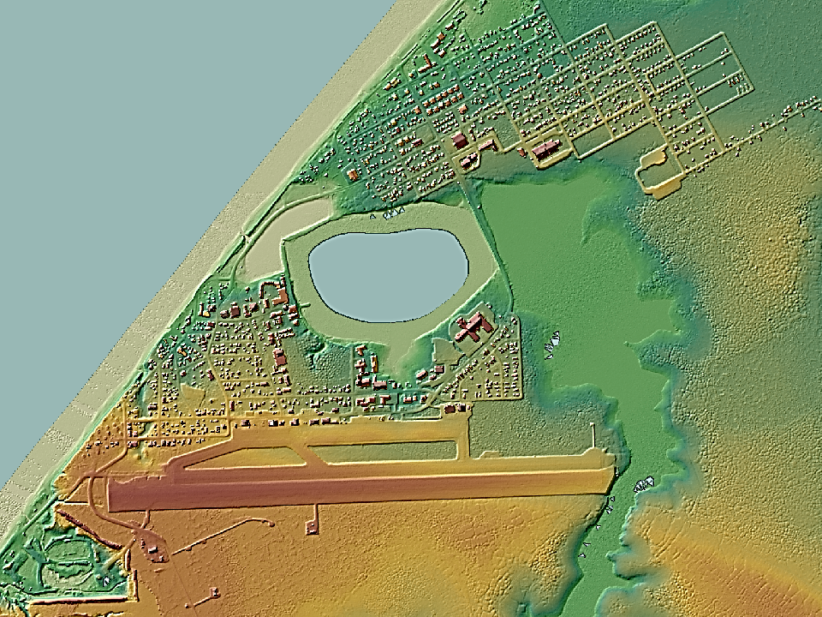
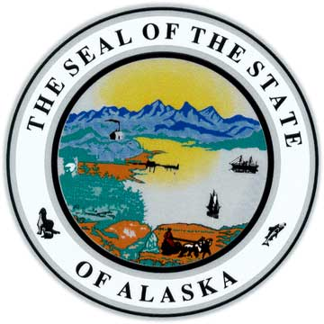
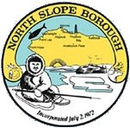
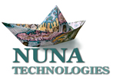
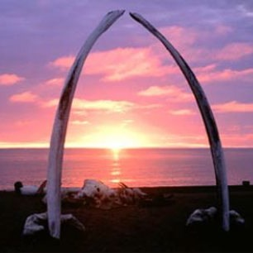
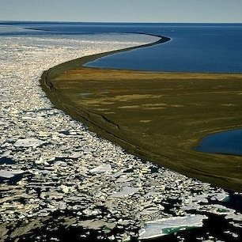
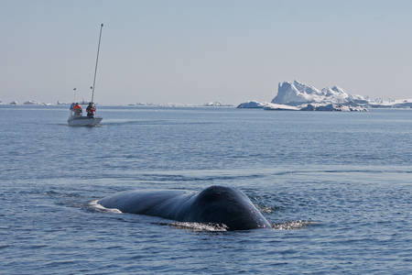
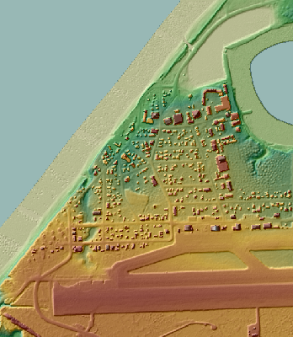
BAID Project
Online Decision Support Tools for
Sustainable Community Development
New apps to assist the Barrow community …
Questions can be directed to Lars.Nelson@UICUmiaq.com
Learn more about climate change, coastal erosion, wetlands, and more through online, interactive maps and tools.
Visualize, navigate, and find scientific datasets and map layers.
Community customized web mapping tools to guide decision making.
A new project, “Barrow Area Information Database (BAID) Decision Support Tools Development”, has been funded by the Coastal Impact Assistance Program to create “web map apps” to assist the Barrow community with environmentally sustainable, low-impact community development.
This project is funded with qualified outer continental shelf oil and gas revenues by the Coastal Impact Assistance Program, Fish and Wildlife Service, U.S. Department of the Interior.
… coming soon.

Slide 2
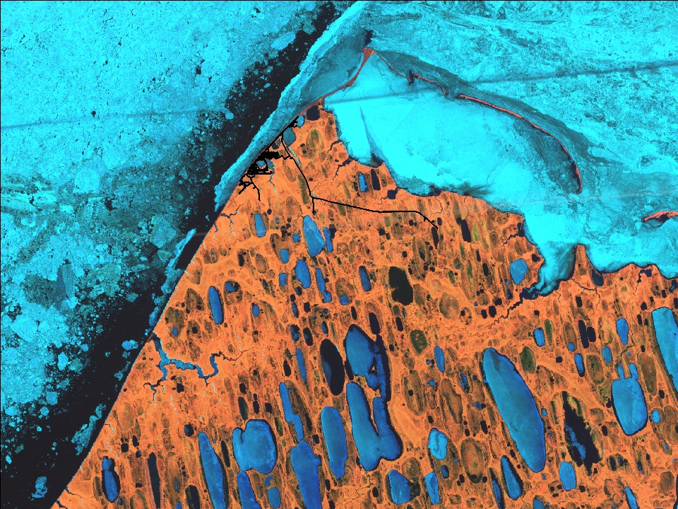
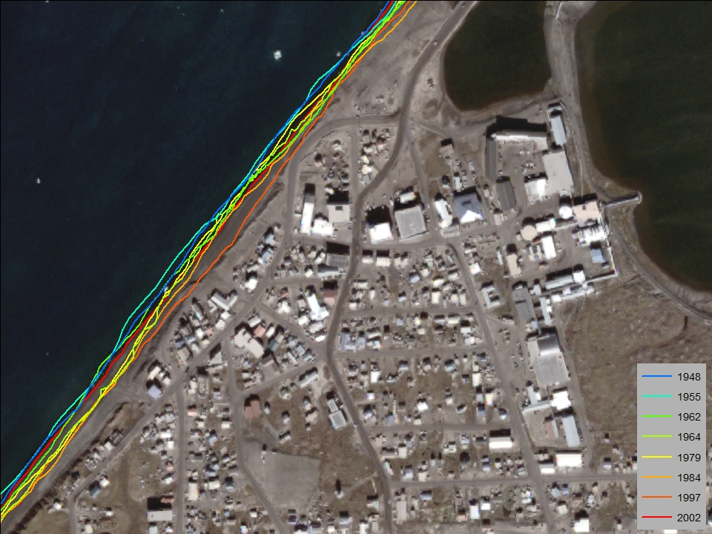
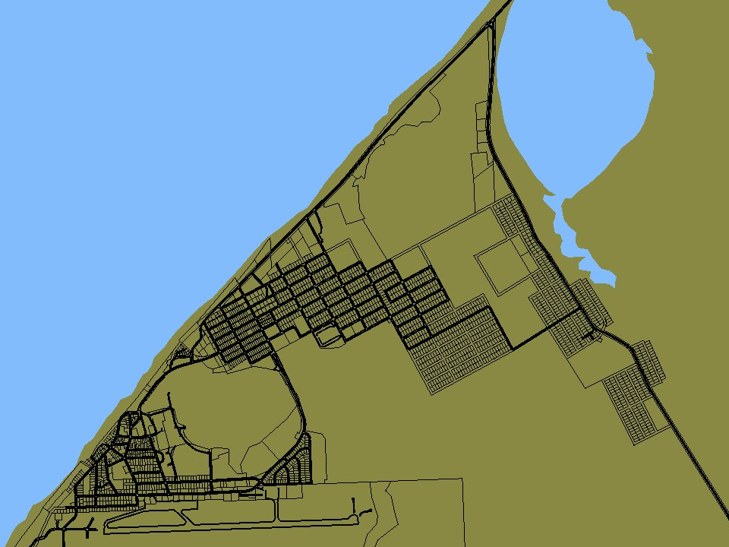
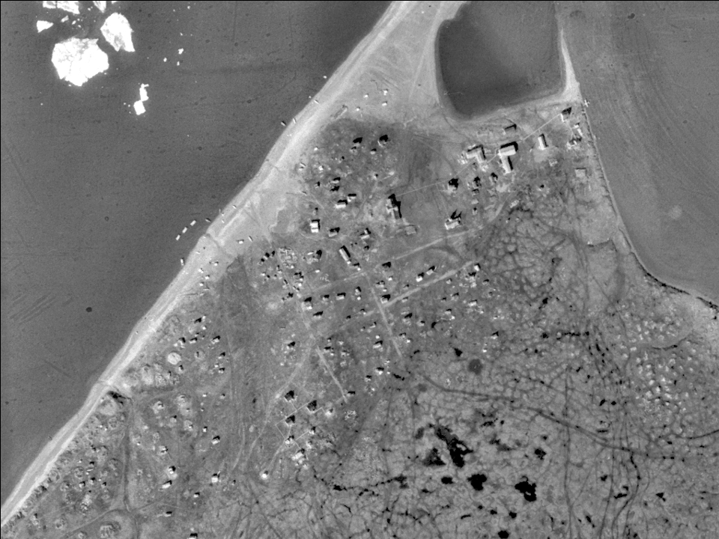
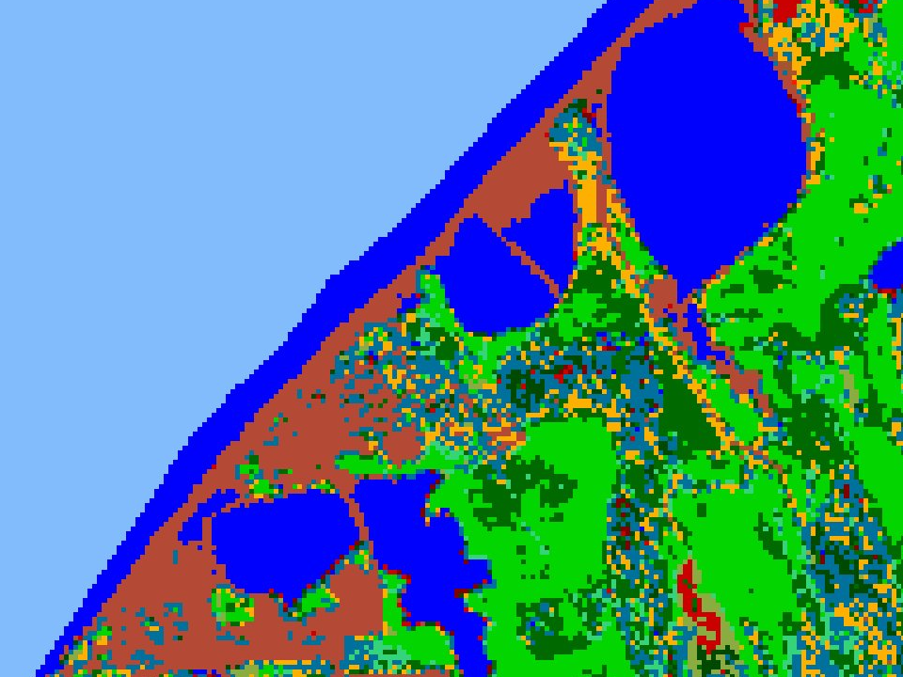
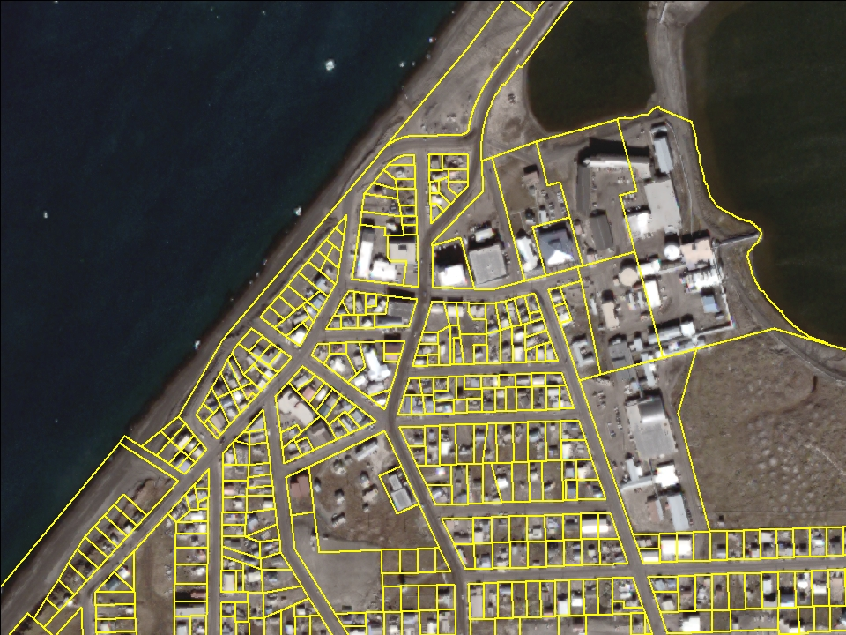
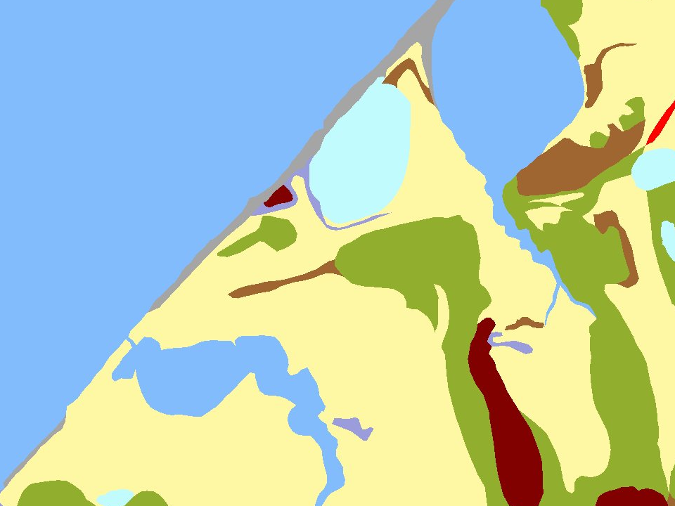
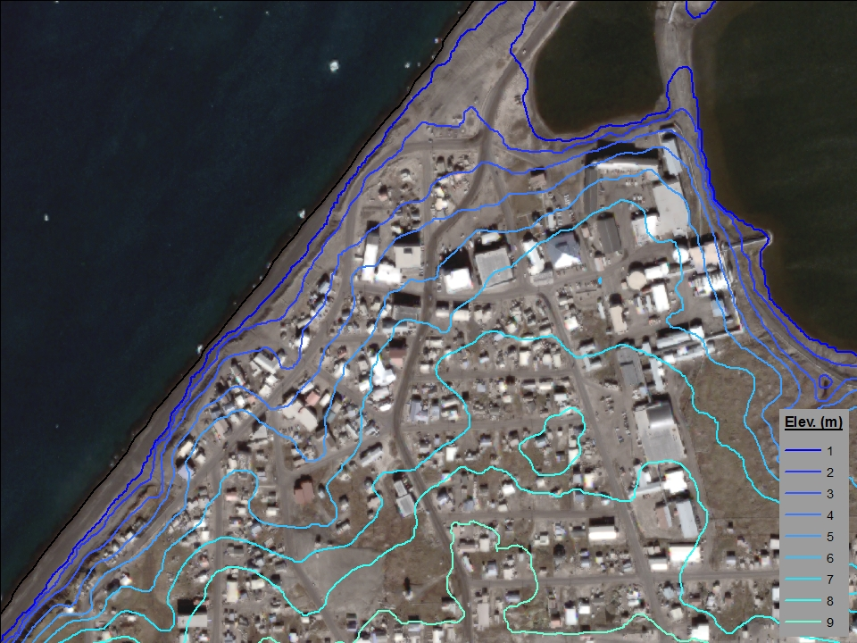
Barrow Area Decision Support Tools
The new web mapping application, accessed through your web browser, will include user-friendly “widgets”:
Community Development Tool
to help guide conservation priorities, endangered and subsistence species protection, oil spill response, planning and zoning for vulnerable areas, etc.
Erosion Assessment Tool
to view past shorelines, erosion rates,
land cover, topography, sea ice, and
more to assess vulnerability
The application will also include numerous map layers such as high-resolution
satellite imagery, historic aerial photography, a new wetlands
map, and other data layers
relating to the environment
and community development.
Barrow
coastal erosion
wetlands
land manage-ment
climate change
scientific mapping
training, education& outreach
Goals:
“Protect Alaska’s coastal areas through
wise management of resource development.”
“Expand capacity for informed, multi-stakeholder
environmental decision making on Ukpeaġvik Iñupiat
Corporation lands in the coastal zone near Barrow, Alaska.”

