Slide 1
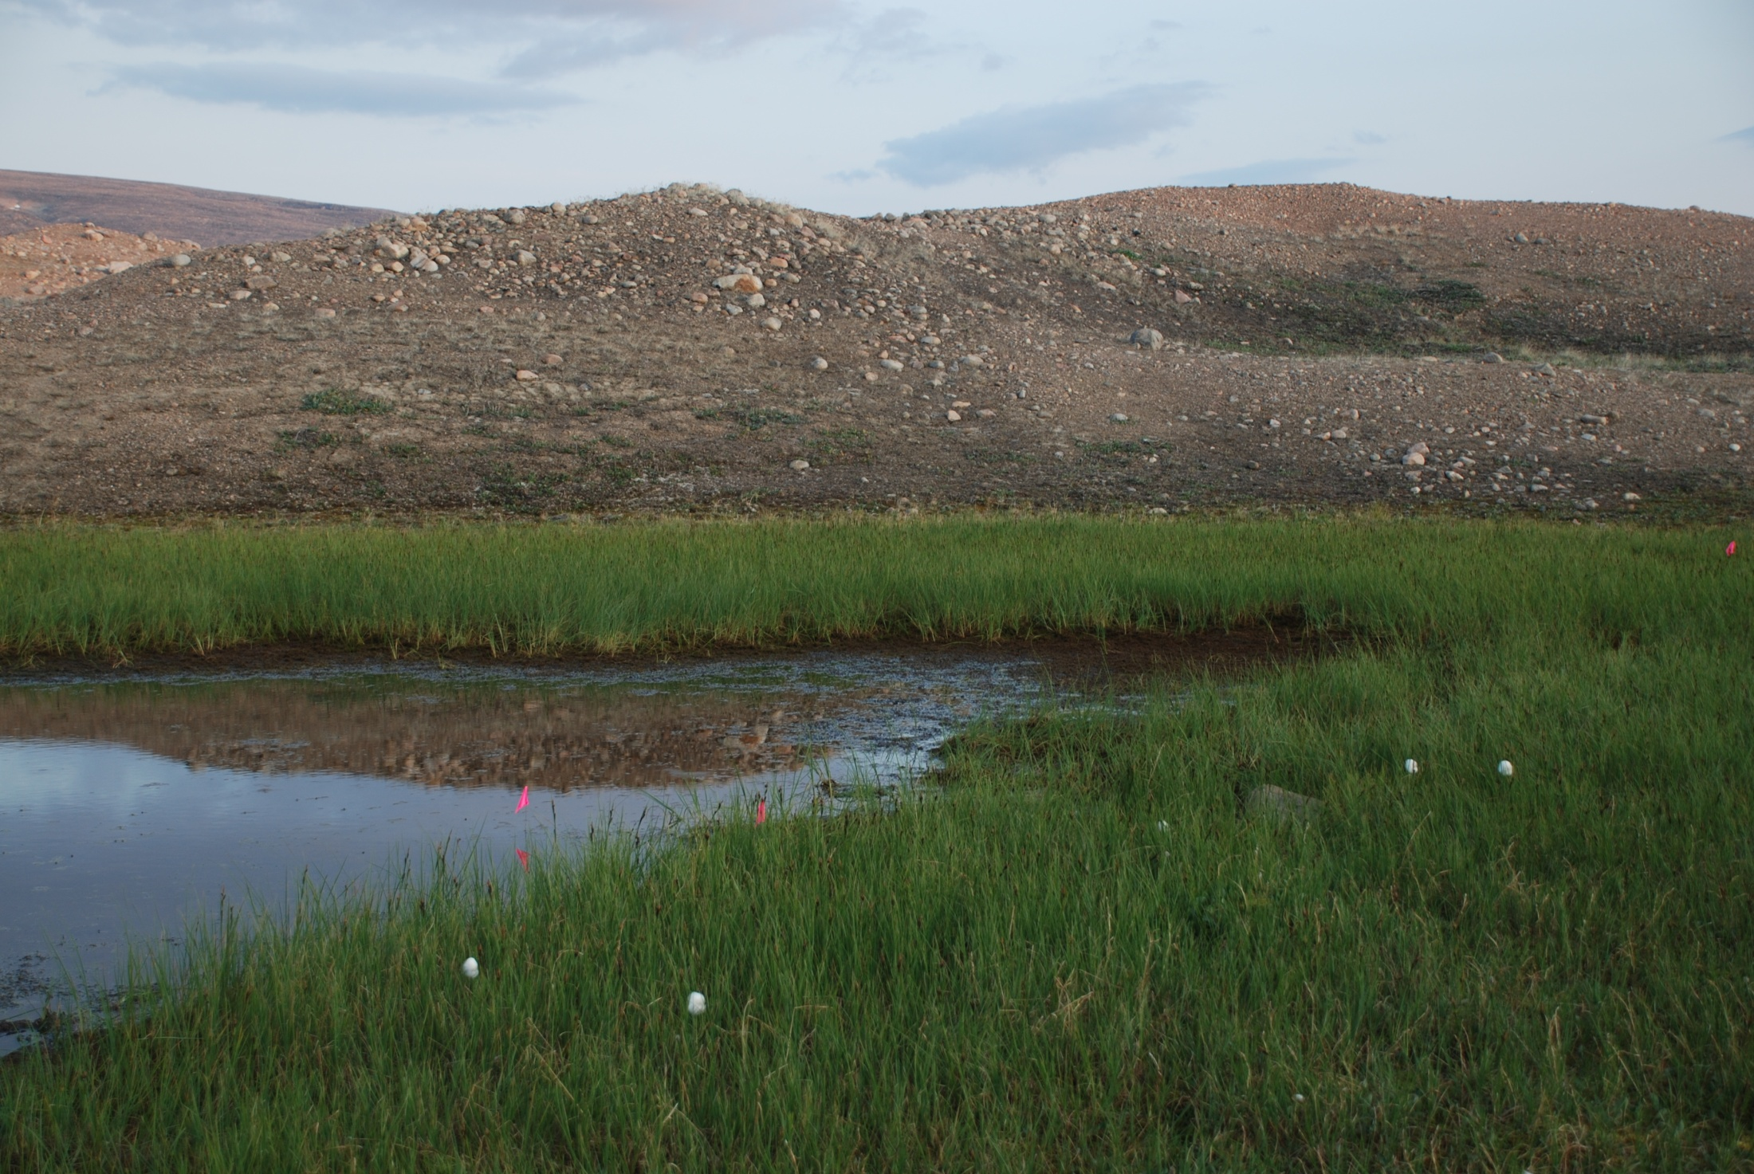
Vegetation datasets from the Barrow area and Baffin Island
Sandra Villarreal
Craig Tweedie
AVA Workshop - Boulder, CO
October 14-16, 2013

Slide 2
UTEP Datasets for AVA….
IPY-BTF data - Resampled sites established by Webber 4-5 decades ago.
Other Data from Barrow – Resampled IBP microtopographic grid, 1950’s herbivore exclosures, ITEX-AON data.
Landcover change maps – high spatial resolution land cover change maps spanning 3-4 decades at multiple sites in Beringia.

Slide 3
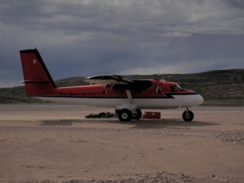
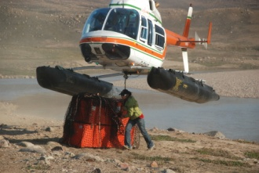
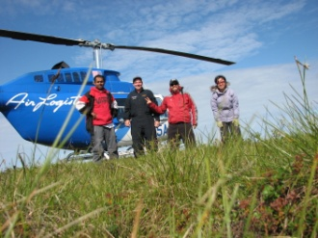
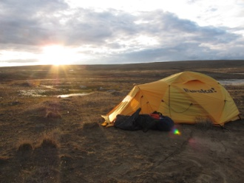
Back to the Future Datasets
IPY- BTF: Resampling of vegetation in marked (mostly) sites established during the 1960’s/70’s by Patrick Webber
NSF funded
IPY contribution

Slide 4
Research Locations
Barrow, Alaska(71.30ºN, -156.69ºW)
Dr. Patrick Webber IBP ordination plots
-Established 1971 (39 years)
-Resampled 1999, 2008, 2010
Atqasuk, Alaska (70.41ºN, -157.41ºW)
Dr. Patrick Webber RATE plots
- Established 1975 (35 years)
-Resampled 2000, 2009
Central Baffin Island(70.442ºN, -74.83ºW)
Dr. Patrick Webber PhD sites
- Established 1964 (45 years)
-Resampled 2009

Slide 6
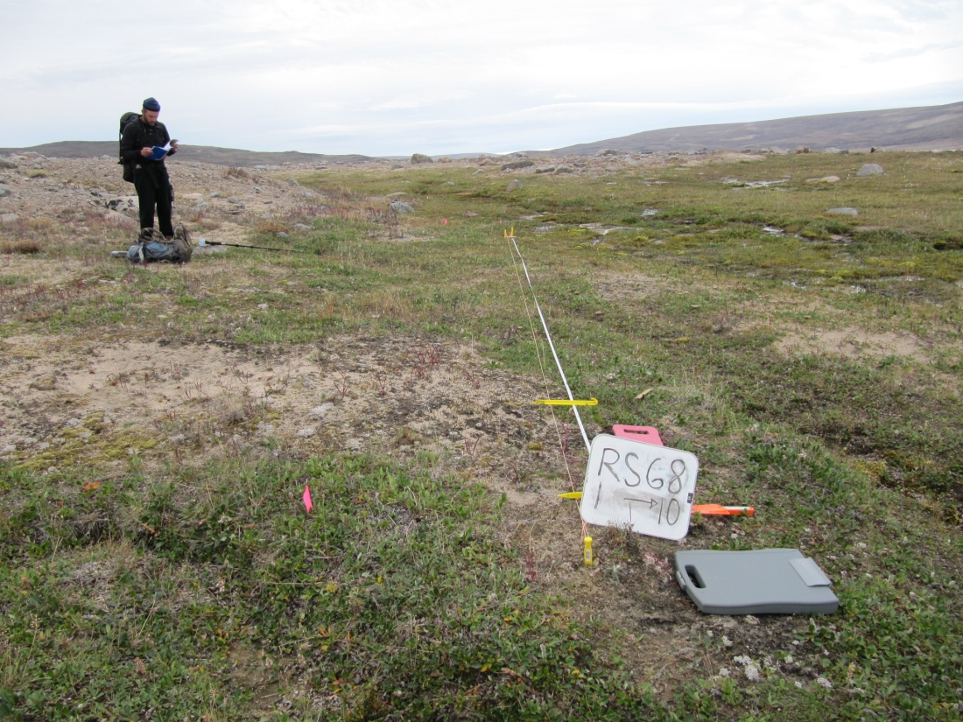
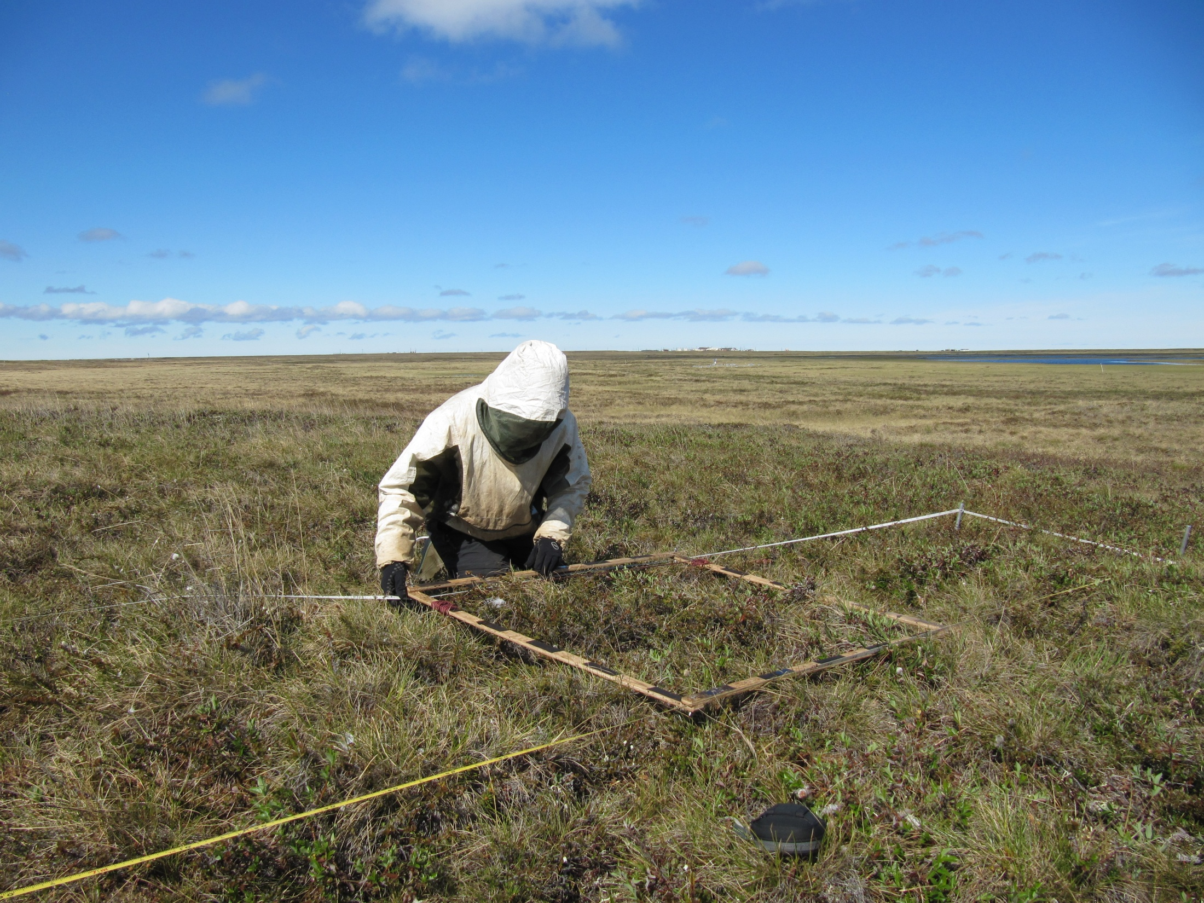
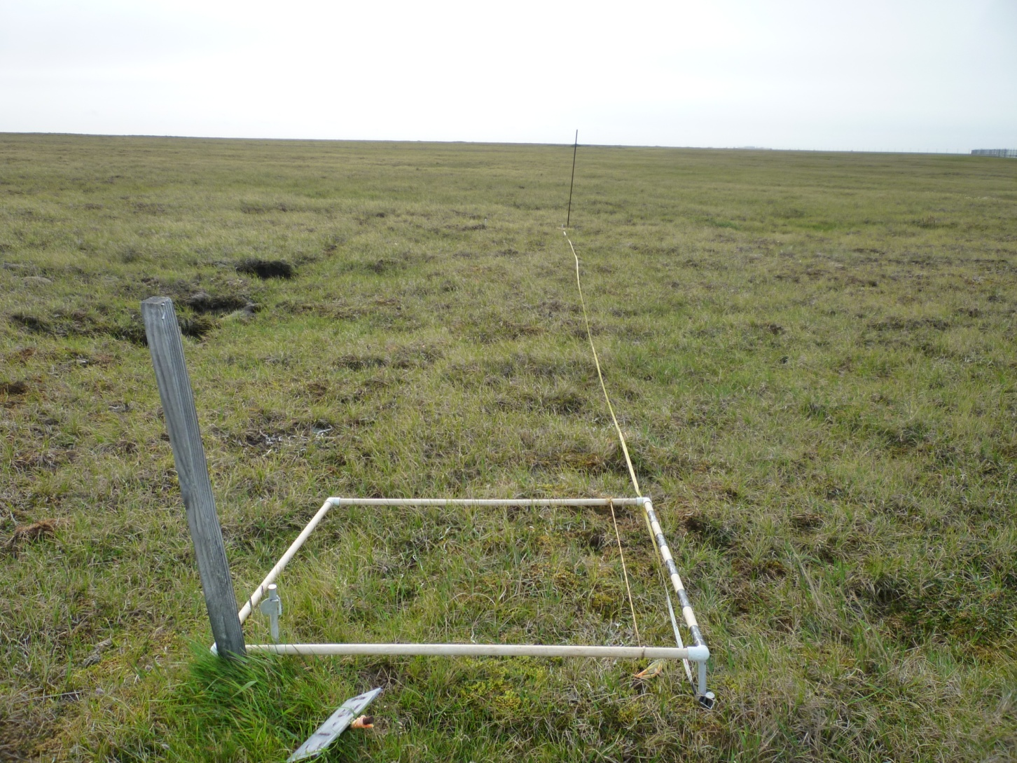
Baffin – Salix arctica meadow
Atqasuk – Carex-Salix moist tundra
Barrow - Moist graminoid tundra
Baffin – Cryptogamic barren

Slide 7
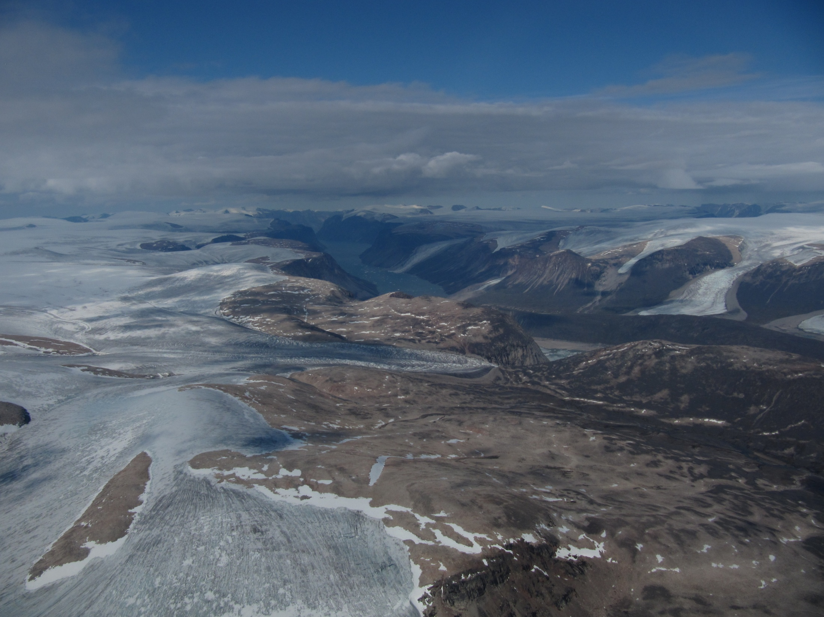
Baffin Island, Canada
CAVM: Cryptogram barren complex
117 species (vascular, bryophyte, lichen)
79 sites
Established: 1964
Resampled: 2009

Slide 8
Barrow, Alaska
CAVM: Sedge/grass, moss wetland
81 species (vascular, lichen, lumped bryophytes)
330 plots
Established: 1972
Resampled: 1999, 2008, 2010

Slide 9
Atqasuk, Alaska
CAVM: Sedge, moss, dwarf-shrub wetland
Low Arctic
Highest abundance of shrubs
213 species in study (vascular, bryophyte, lichen)
31 sites
Established: 1975
Resampled: 2000, 2009

Slide 10
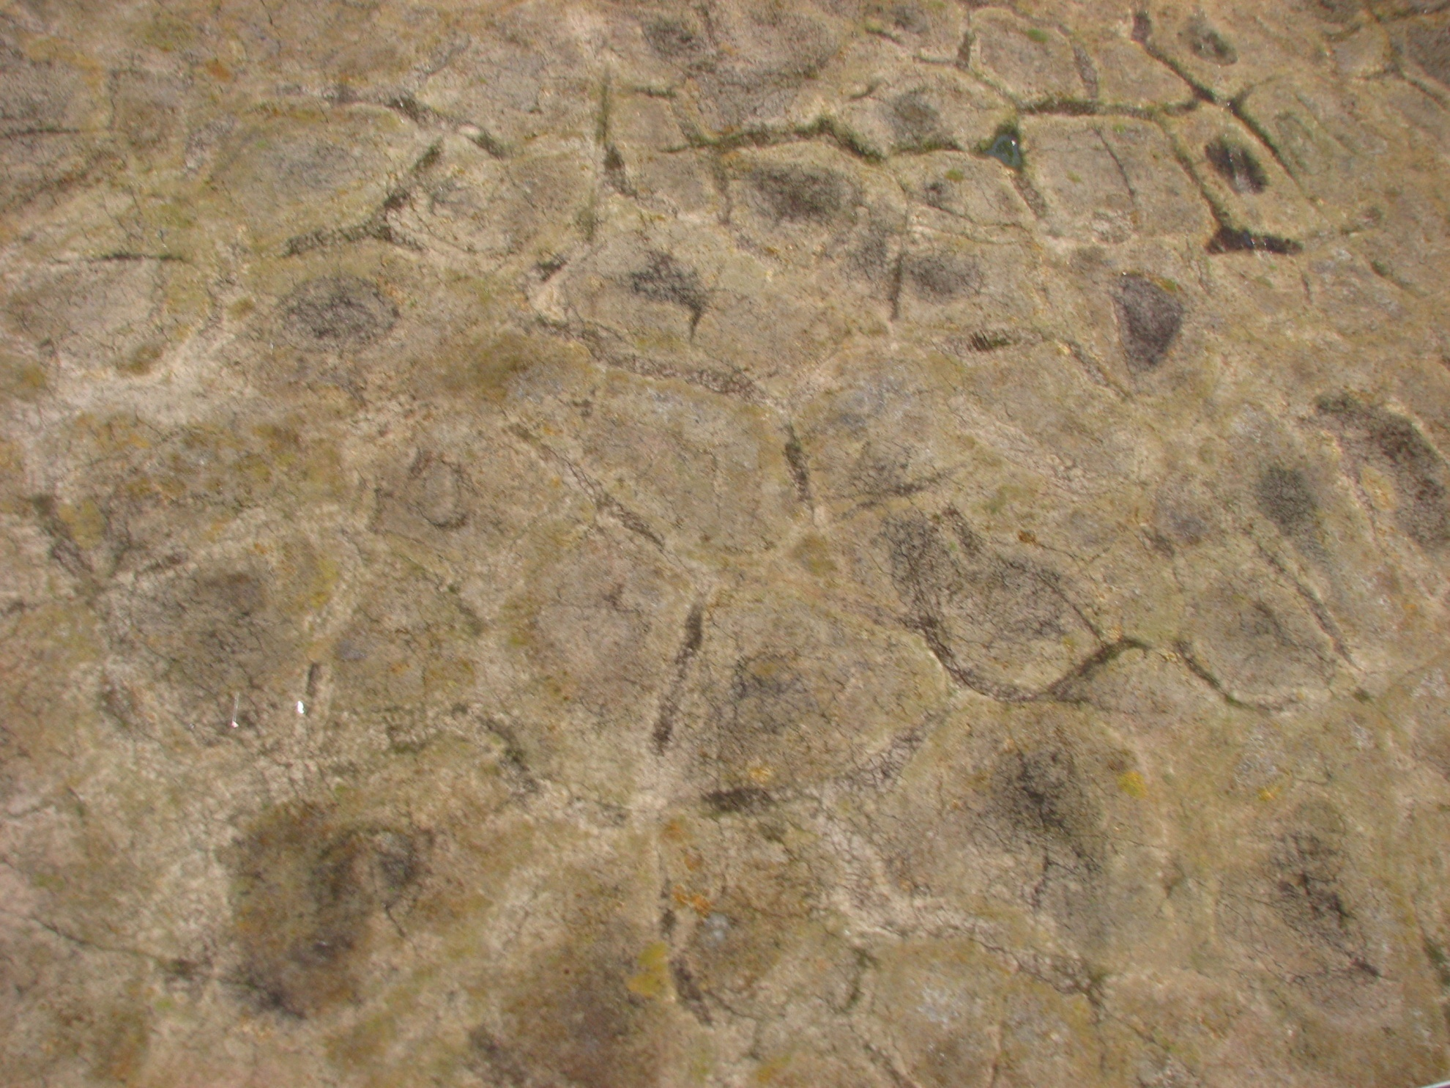
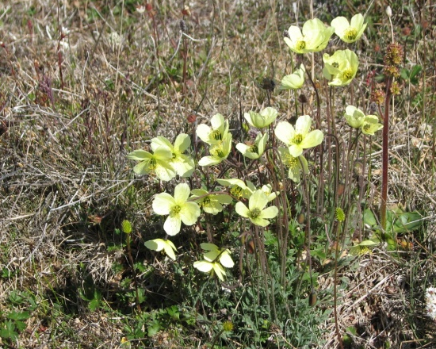
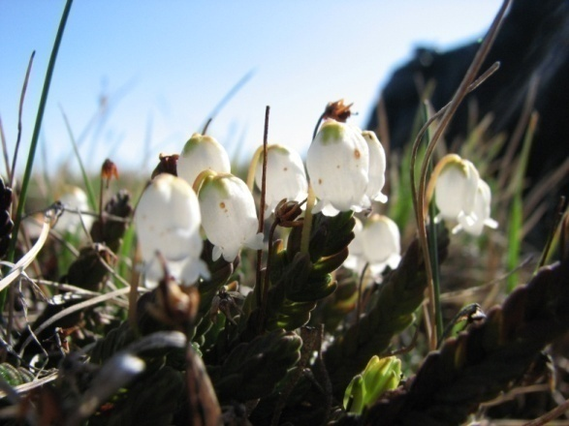
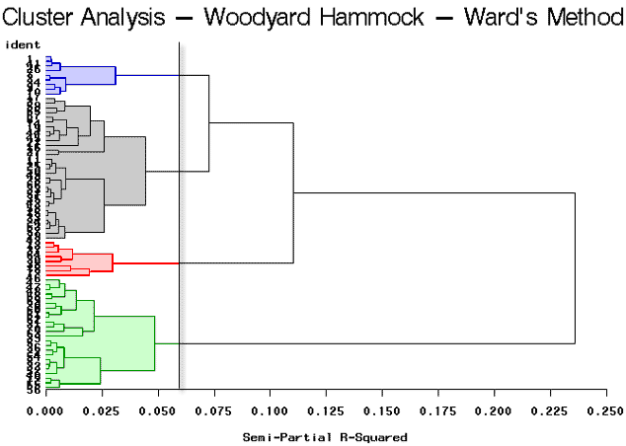
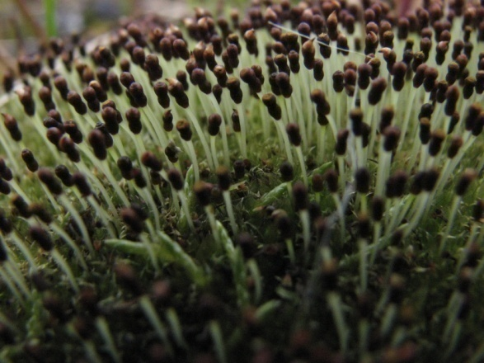
Data analysis
Relativized Presence and Cover
Species Presence
Species Index Value
Species Percent Cover
1 m
1
2
3
4
5
6
7
8
9
10
1m
Nonmetric Multidimensional Scaling
Site x Species Matrix
10 m
Hierarchical Cluster Analysis
Notes:
Vasculars, lichens, mosses

Slide 11
Relativized Presence and Cover
Species Index Value
Species Percent Cover
Changes in communities, functional groups, diversity, and individual species
Site x Species Matrix
Hierarchical Cluster Analysis
Notes:
Vasculars, lichens, mosses

Slide 12
Summary of change analysis
Baffin Island, CAN
Increased Summer Warmth Index
Repeat photography (1964-2009): loss of snowbanks, Lewis Glacier retreat, vegetation change
Directional vegetation community change in NMDS
Evenness and diversity increased (1964-2009)
Increase in forbs, lichens, mosses (1964-2009)
Atqasuk, AK
Little vegetation community change NMDS
No changes in functional groups (1975-2009)
Increased evenness (1975-2009, 2000-2009)
Barrow, AK
No overarching directional vegetation community change in NMDS
More change in wet sites in NMDS
Increased species richness and diversity (1972-2010)
Herbivores can mask long-term changes and cause short-term variability (Villarreal et al. 2012)

Slide 13
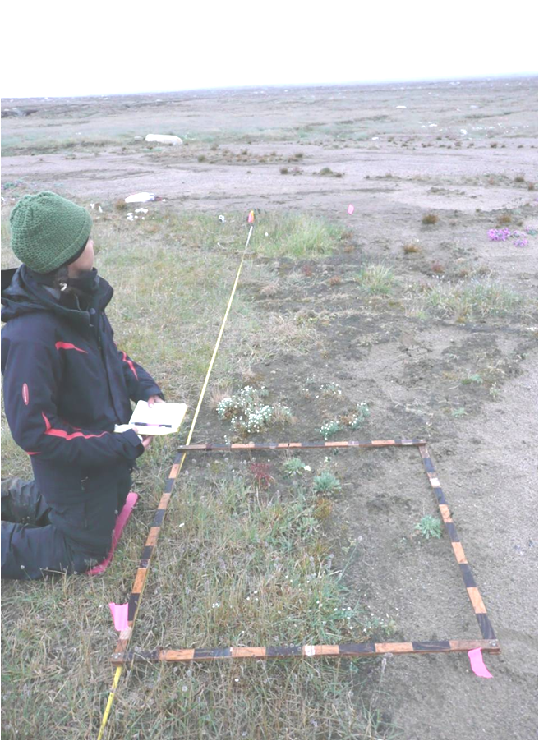
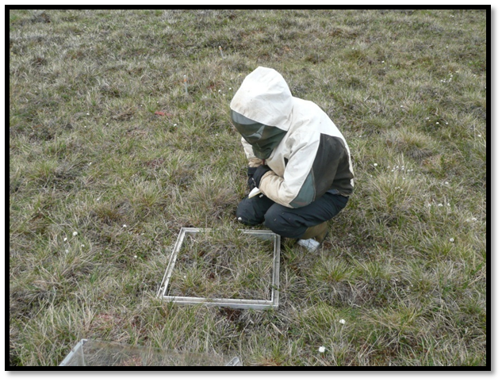
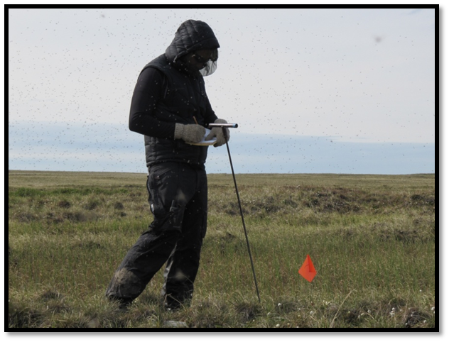
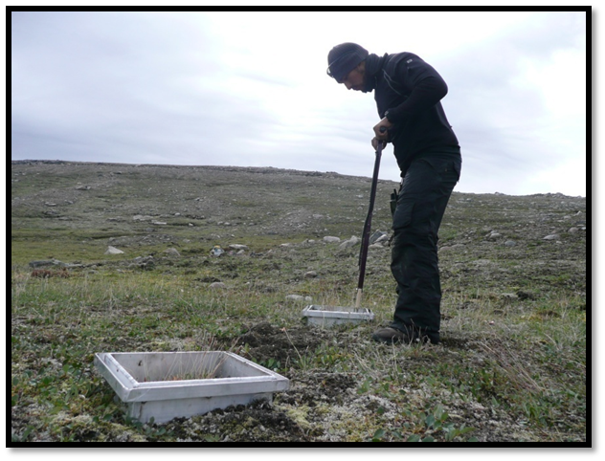
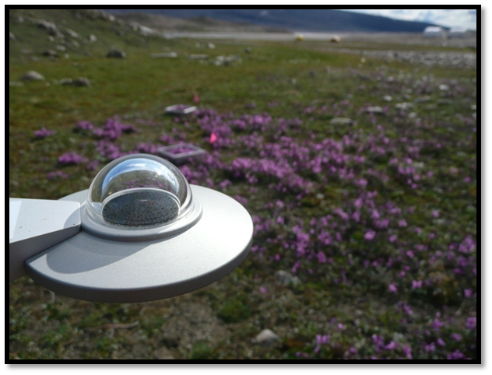
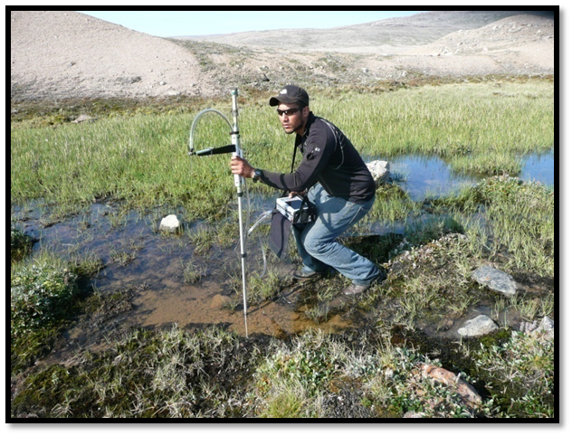
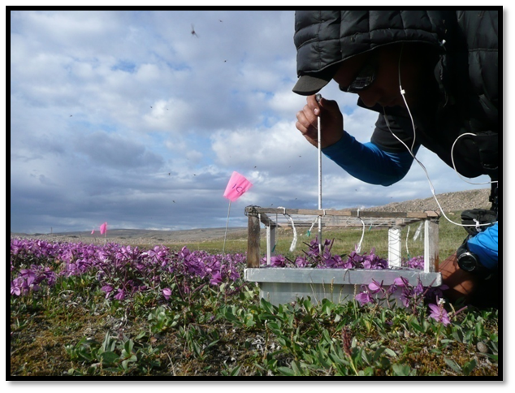
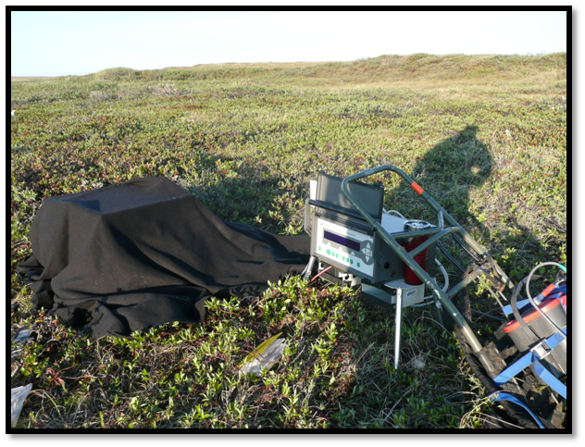
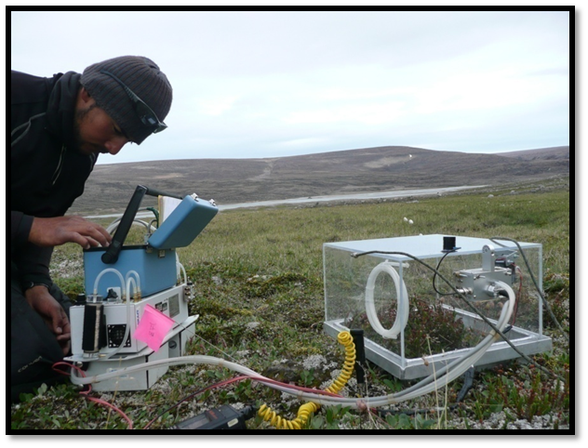
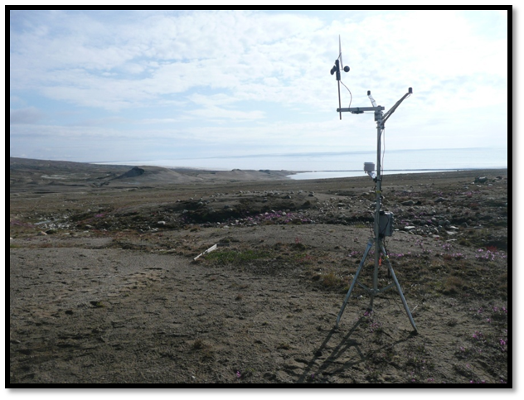
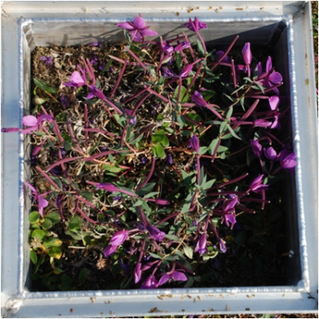
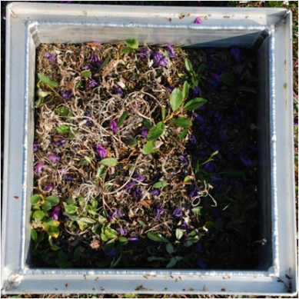
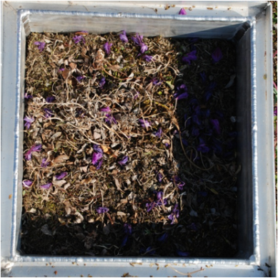
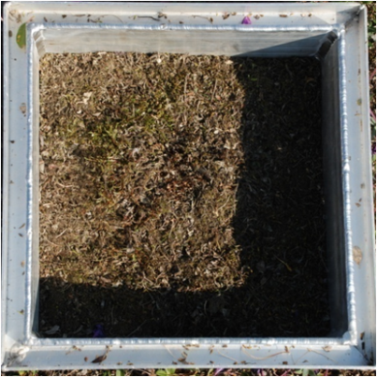
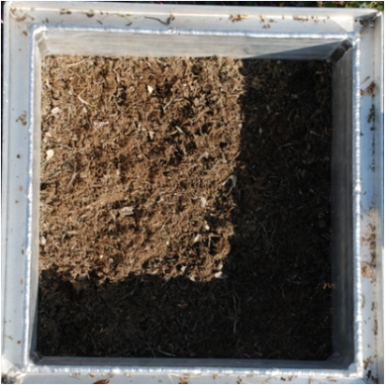
Sampling of Ecosystem Function
Both
Marked vegetation sites
Measurements of ecosystem function

Slide 14
Status of datasets
 | Marked Vegetation Sites |  |  | Measurements of Ecosystem Function
 | Barrow | Atqasuk | Baffin Island | Barrow | Atqasuk | Baffin Island
MS Access | X | X | X | X | X | X
QA/QC | X | X | X | X | X | X
Analysis | X | X | X | X | In process | X
Publication | Villarreal et al. 2012 | Villarreal 2013 | Villarreal 2013 | Lara et al. 2012 |  | Lara 2012, Villarreal 2013

Slide 15
UTEP Datasets for AVA….
IPY-BTF data - Resampled sites established by Webber 4-5 decades ago.
Other Data from Barrow – Resampled IBP microtopographic grid, 1950’s herbivore exclosures, ITEX-AON data.
Landcover change maps – high spatial resolution land cover change maps spanning 3-4 decades at multiple sites in Beringia.

Slide 16
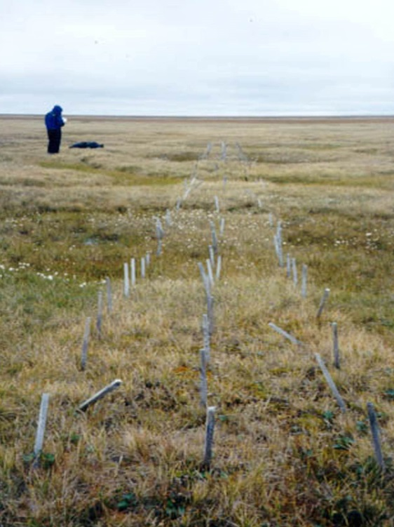
Microtopography Grid – Barrow, AK
34m
1m
50cm
Established during IBP
136 plots 50x50cm plots
Vegetation sampled in 1973, 2000, 2008
All vascular plants and lichen species
Bryophytes lumped
1973
2000

Slide 17
Microtopography Grid – Barrow, AK
Positioned along polygonal tundra
Environmental data
DGPS, LiDAR, plot photos, soil moisture, thaw depth, spectral reflectance, albedo, kite aerial photography, DGPS/LiDAR elevation

Slide 18
Microtopography Grid – Barrow, AK
Water table depth, carbon flux (CO2/CH4) at peak season, LAI, biomass, climate data
Mark Lara

Slide 19
Herbivory Exclosures – Barrow, AK
Exclosures and control plots in dry, moist, wet tundra
Plant species cover and abundance in 2002 and 2010
Vascular species, lichens and bryophytes were
Dr. David Johnson

Slide 20
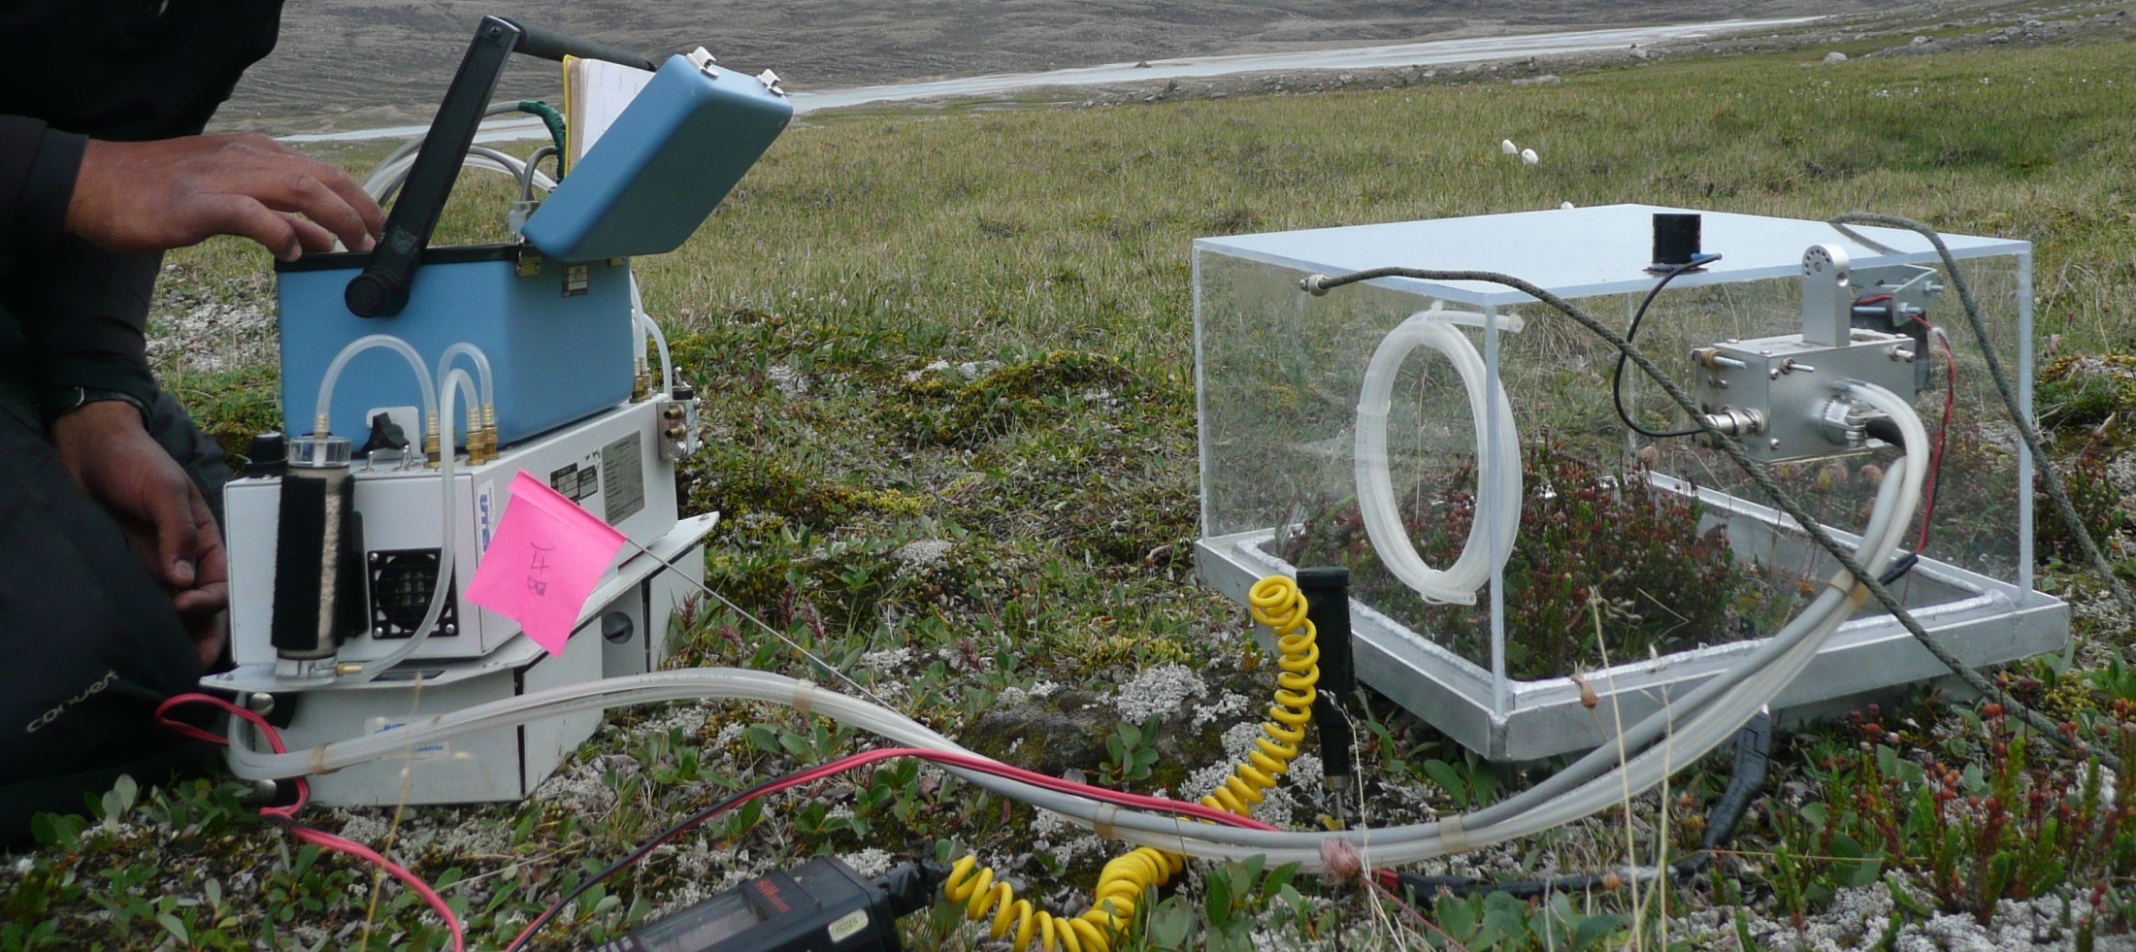
Carbon flux
Photosynthesis & Respiration, CH₄ emissions
Dr. Mark Lara

Slide 21
Environmental data
Biomass, soil moisture, active layer depth, water table depth, hyperspectral reflectance, albedo, climate data
Carbon flux (CO2 and CH4)
Dr. Mark Lara

Slide 22
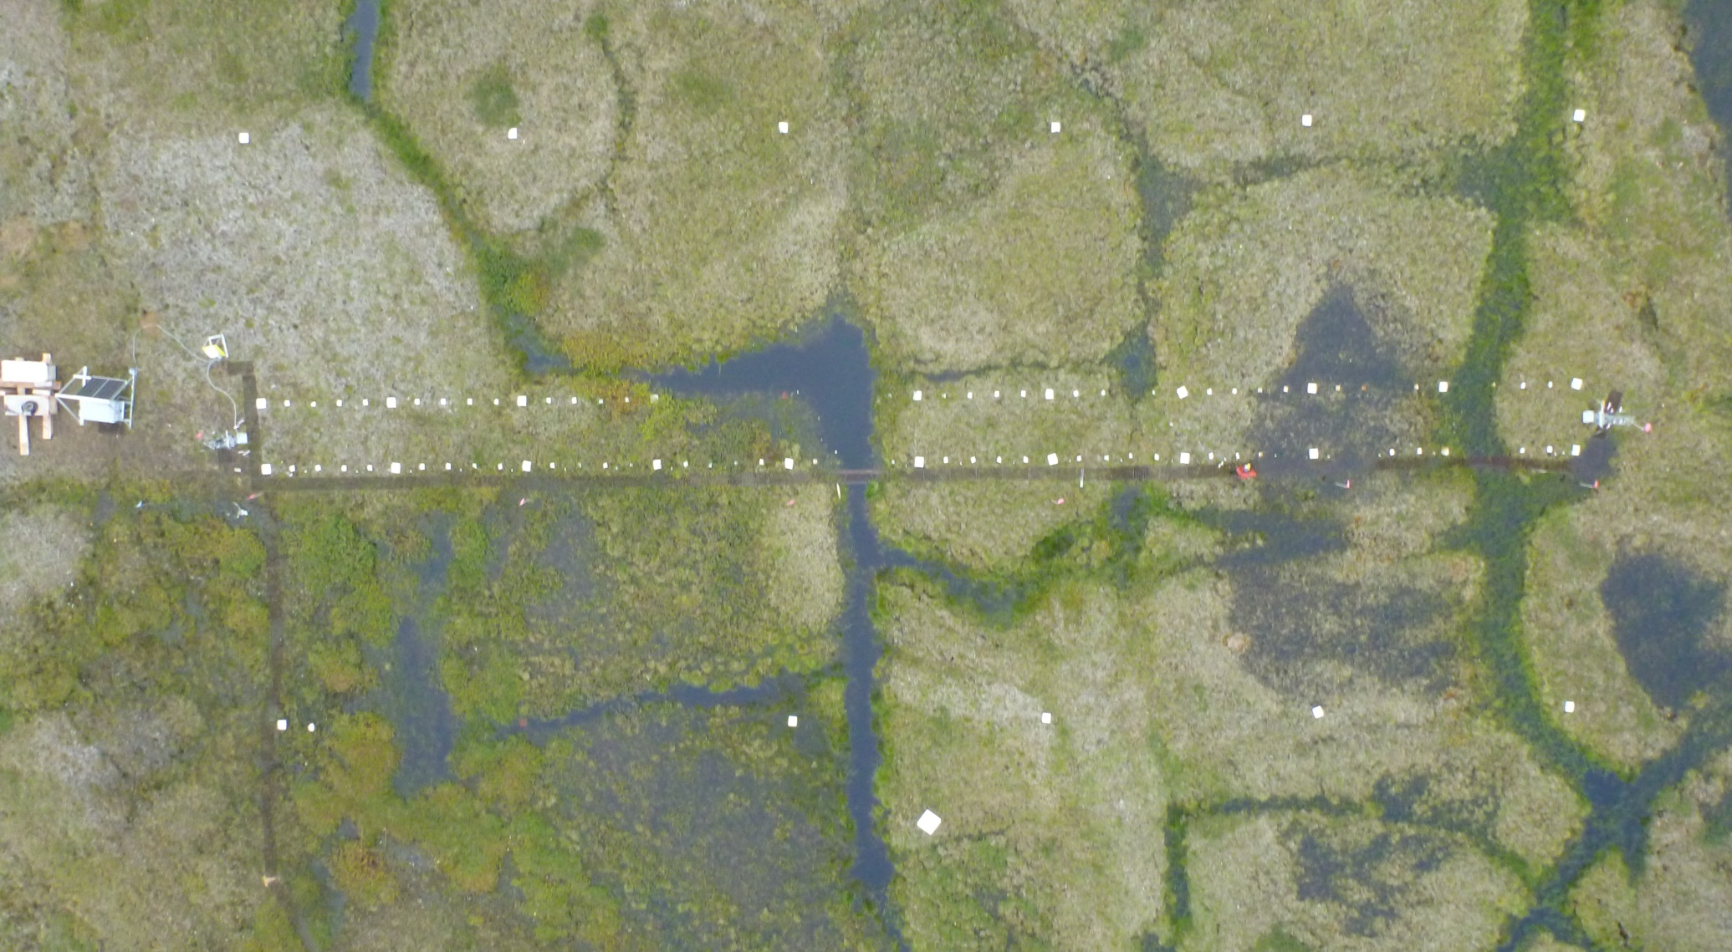
AON MISP Grids
Arctic Observatory Network – Mobile Instrumented Sensor Platform
Barrow and Atqasuk, Alaska

Slide 23
AON MISP Grids
2m
1
2
4
3
50m
1) Dry Heath
2) Shrub Tundra
3) Wet Meadow
4) Moist acidic tundra
Notes:
Mobile Instrumented Sensor Platform (MISP)
Platform contains the following sensors on board:
1) Kipp & Zonen CNR4 Net Radiometer
2) Fuji 3-D Camera
3) Apogee Instruments SI-111 infrared temperature sensor
4) Hewlett Packard Mini PC
5) Campbell Scientific SR50a sonic distance sensor
6) Campbell Scientific CR3000 data logger
7) Trimble GreenSeeker RT100- NDVI sensor
8) Ocean Optics Jaz Combo-2 Spectrometer with fiber optics
9)Timelapse tower cameras
Notes:
-Large white board on the outside of the grid are 10 meters apart and were setup as GCPs
-Boards on the grid: Large boards mark every 5 meters and small boards mark every meter
-Extra large white board at the bottom of the image serves as a white reference panel
-Vegetation types being monitored:
1) Dry Heath- (Black)
2) Shrub Tundra- (Red)
3) Wet Meadow- (Orange)
4) Moist acidic tundra- (Blue)

Slide 24
AON MISP Grids
Percent cover on all vascular, bryophyte, and lichen species along entire grid
Jeremy May, Jennifer Liebig (GVSU)
Environmental data –GPS, LIDAR, soil moisture, soil temperature, spectral reflectance, kite aerial photography, time lapse imagery, active layer depth, water table depth, snow depth, climate data
UTEP, GVSU, FIU personnel
36 meter square sites across the Barrow and Atqasuk ARCSS grids

Slide 25
Status of other datasets in the Barrow area
 | Microtopography Grid | Herbivory Exclosures | AON-MISP Grid
MS Access | X | X | X
QA/QC | In process | X | In process
Analysis | In process | X | In process
Published | In prep | Lara 2012, Johnson et al. 2011 | In review (Healey et al.)

Slide 26
UTEP Datasets for AVA….
IPY-BTF data - Resampled sites established by Webber 4-5 decades ago.
Other Data from Barrow – Resampled IBP microtopographic grid, 1950’s herbivore exclosures, ITEX-AON data.
Landcover change maps – high spatial resolution land cover change maps spanning 3-4 decades at multiple sites in Beringia.

Slide 27
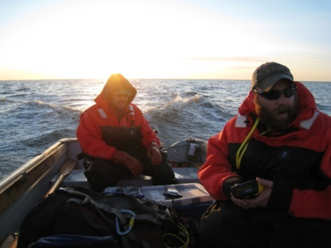
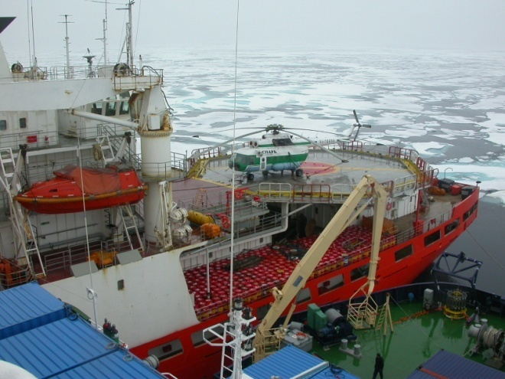
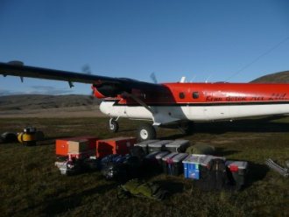
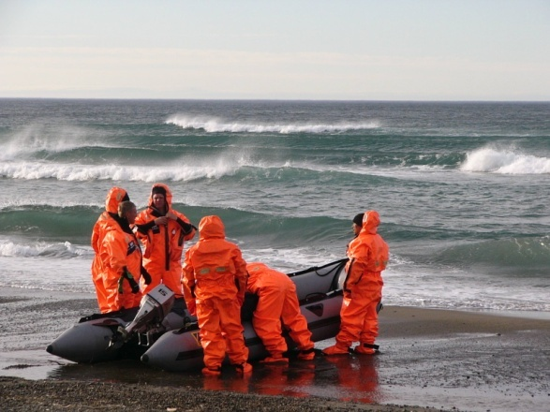
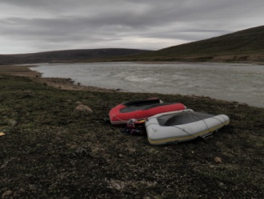
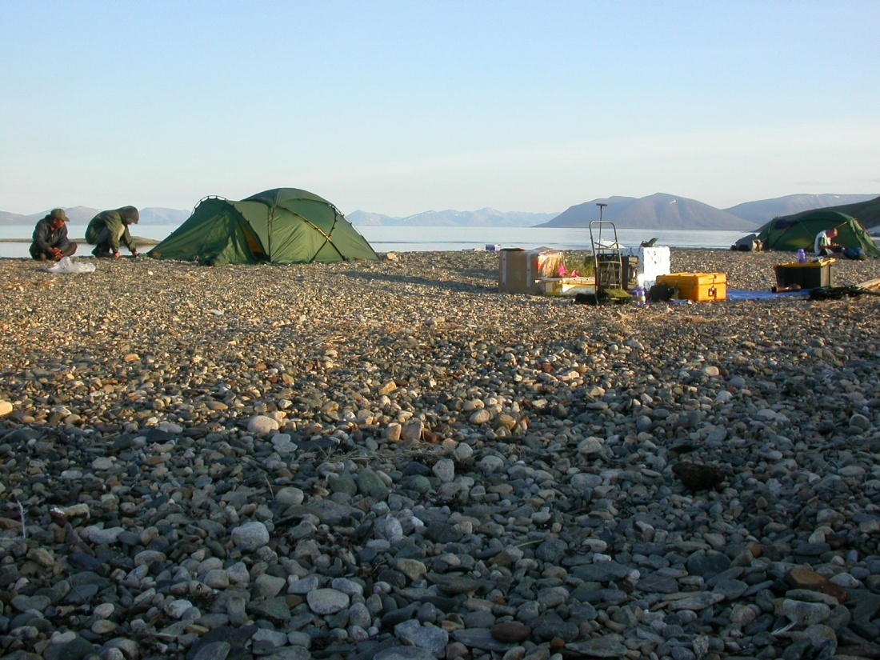
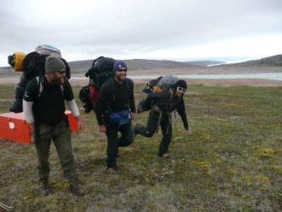
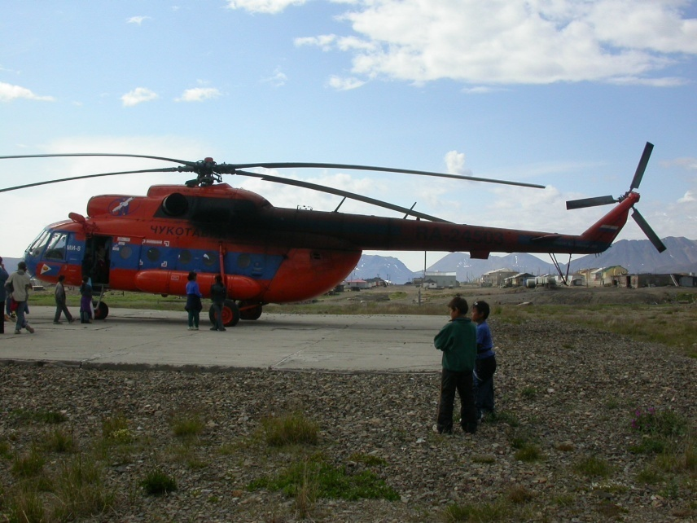
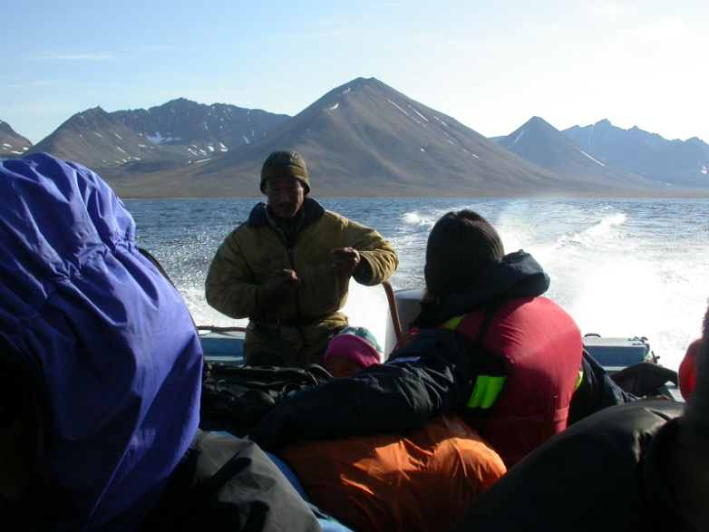
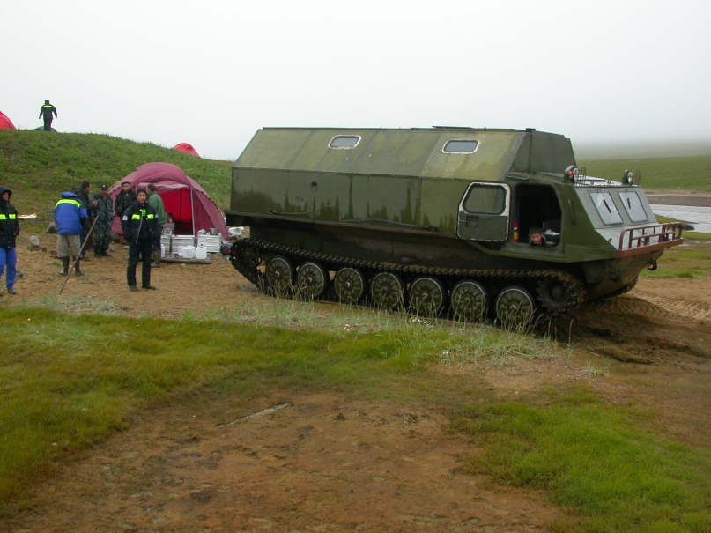
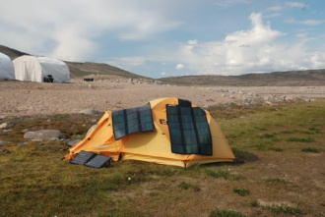
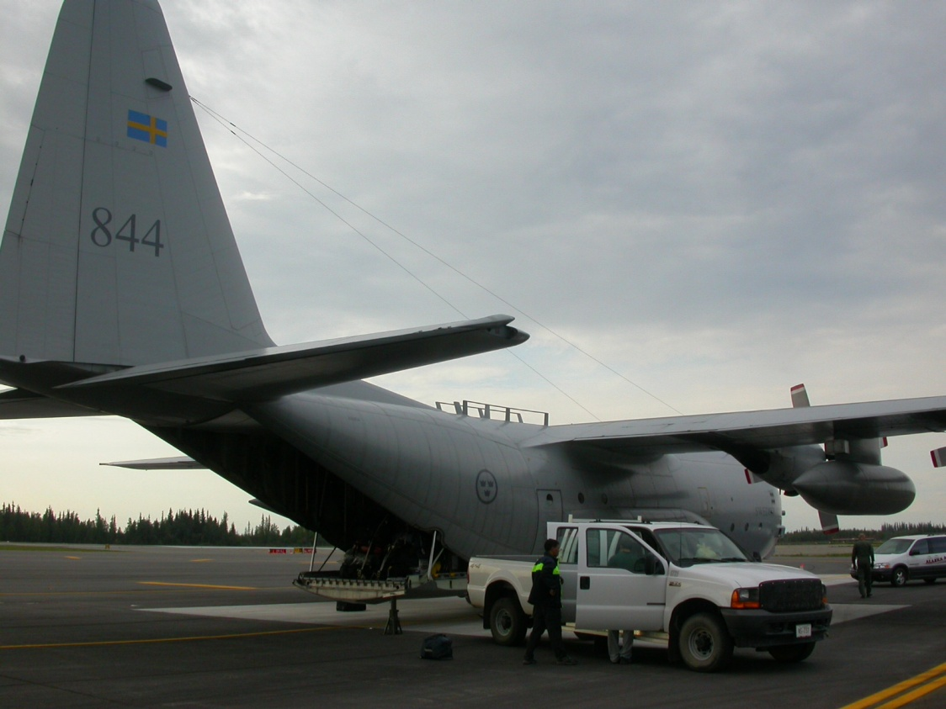
3. Beringia Land Cover Change…
Picture of the arctic from space

Slide 28
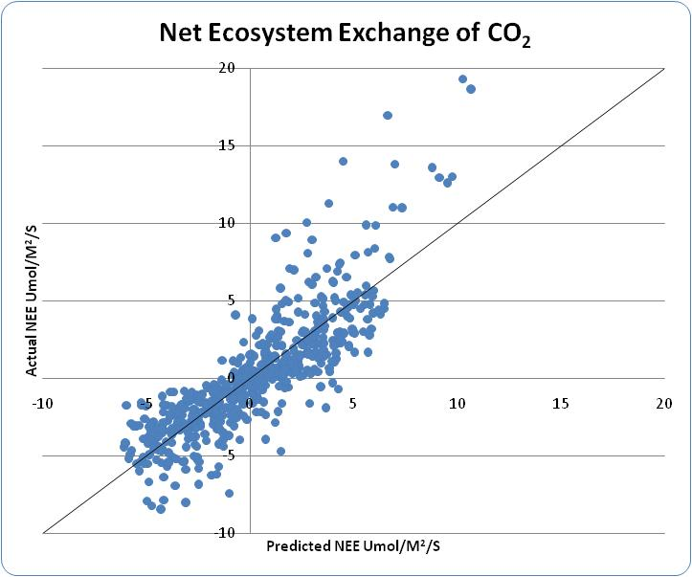
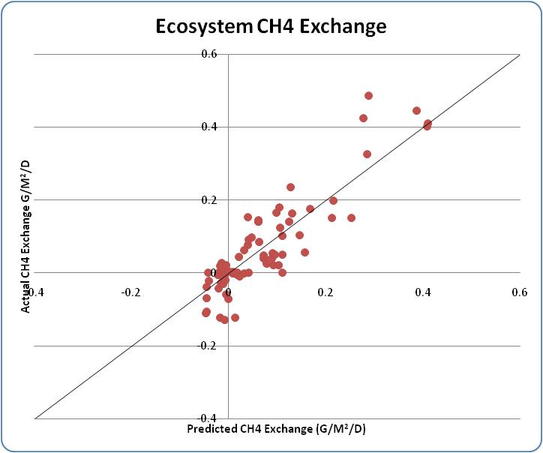
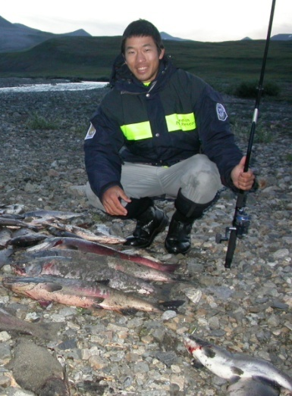
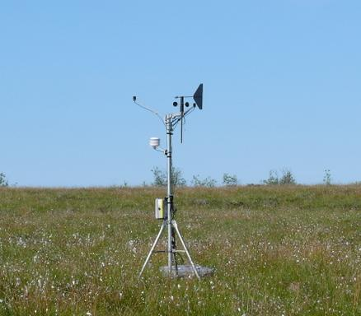
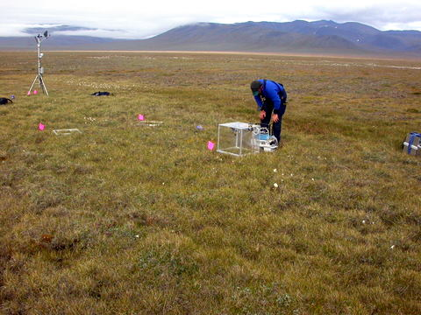
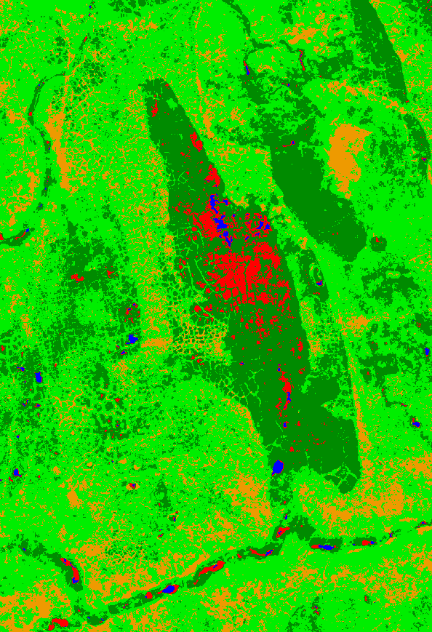
Model change in ecosystem function from land cover change…
PAR
T_{air}
LAI
NDVI
Dry Soil
Standing H₂0
VWC
Standing H₂0
Dry Soil
VWC
Wet Soil
T_{air}
NDVI
NDSWI
R²adj=0.71, P < 0.001, N = 566, RMSE=0.1364
R²adj=0.75, P < 0.001, N = 88, RMSE=0.1364
20% increase
2002
2008

Slide 29
Barrow Land Cover Change 1948-2008 (from Lin et al. 2012)….

Slide 30
Challenges and additional comments
Standardizing metadata format
Standardizing nomenclature

Slide 31
Acknowledgements/Questions
UTEP - Systems Ecology Laboratory
Dr. Craig Tweedie
Dr. Vanessa Lougheed
Dr. David Johnson
Dr. Mark Lara
Christian Andresen
David Lin
Gilda Victorino
Ryan Cody
Paul Hotchkins
National Science Foundation
Grand Valley State University
Dr. Robert D. Hollister
Jeremy May
Robert Slider
Jenny Liebig
Dr. Patrick J. Webber

Slide 32
Data Overview
 | BTF Datasets |  |  | Barrow Area Datasets |  |  | Beringia Dataset
 | Barrow, AK | Atqasuk, AK | Baffin Island | Microtopography Grid | Herbivory Exclosures | AON MISP Grid
Years Sampled | 2008 | 2009 | 2009 | 1971, 1999, 2008 | 1959, 2000, 2009 | 2011, 2012, 2013
Vascular Spp | X | X | X | X | X | X
Bryophyte Spp |  | X | X |  |  | X
Lichen Spp | X | X | X | X | X | X
GPS | X | X | X | X | X | X | X
Plot photo | X | X | X | X | X | X | X
Repeat photo | X | X | X
Thaw Depth | X | X | X | X | X | X | X
Soil Moisture | X | X | X | X | X | X | X
LAI | X | X | X | X |  |  | X
Biomass harvest | X | X | X | X | X |  | X
Albedo | X | X | X | X | X | X | X
Spectral reflectance | X | X | X | X |  | X | X
Carbon Flux | X | X | X | X | X |  | X
Kite photography |  |  |  | X |  | X
LiDAR |  |  |  | X |  | X
Notes:
Summary of all data

