Slide 1
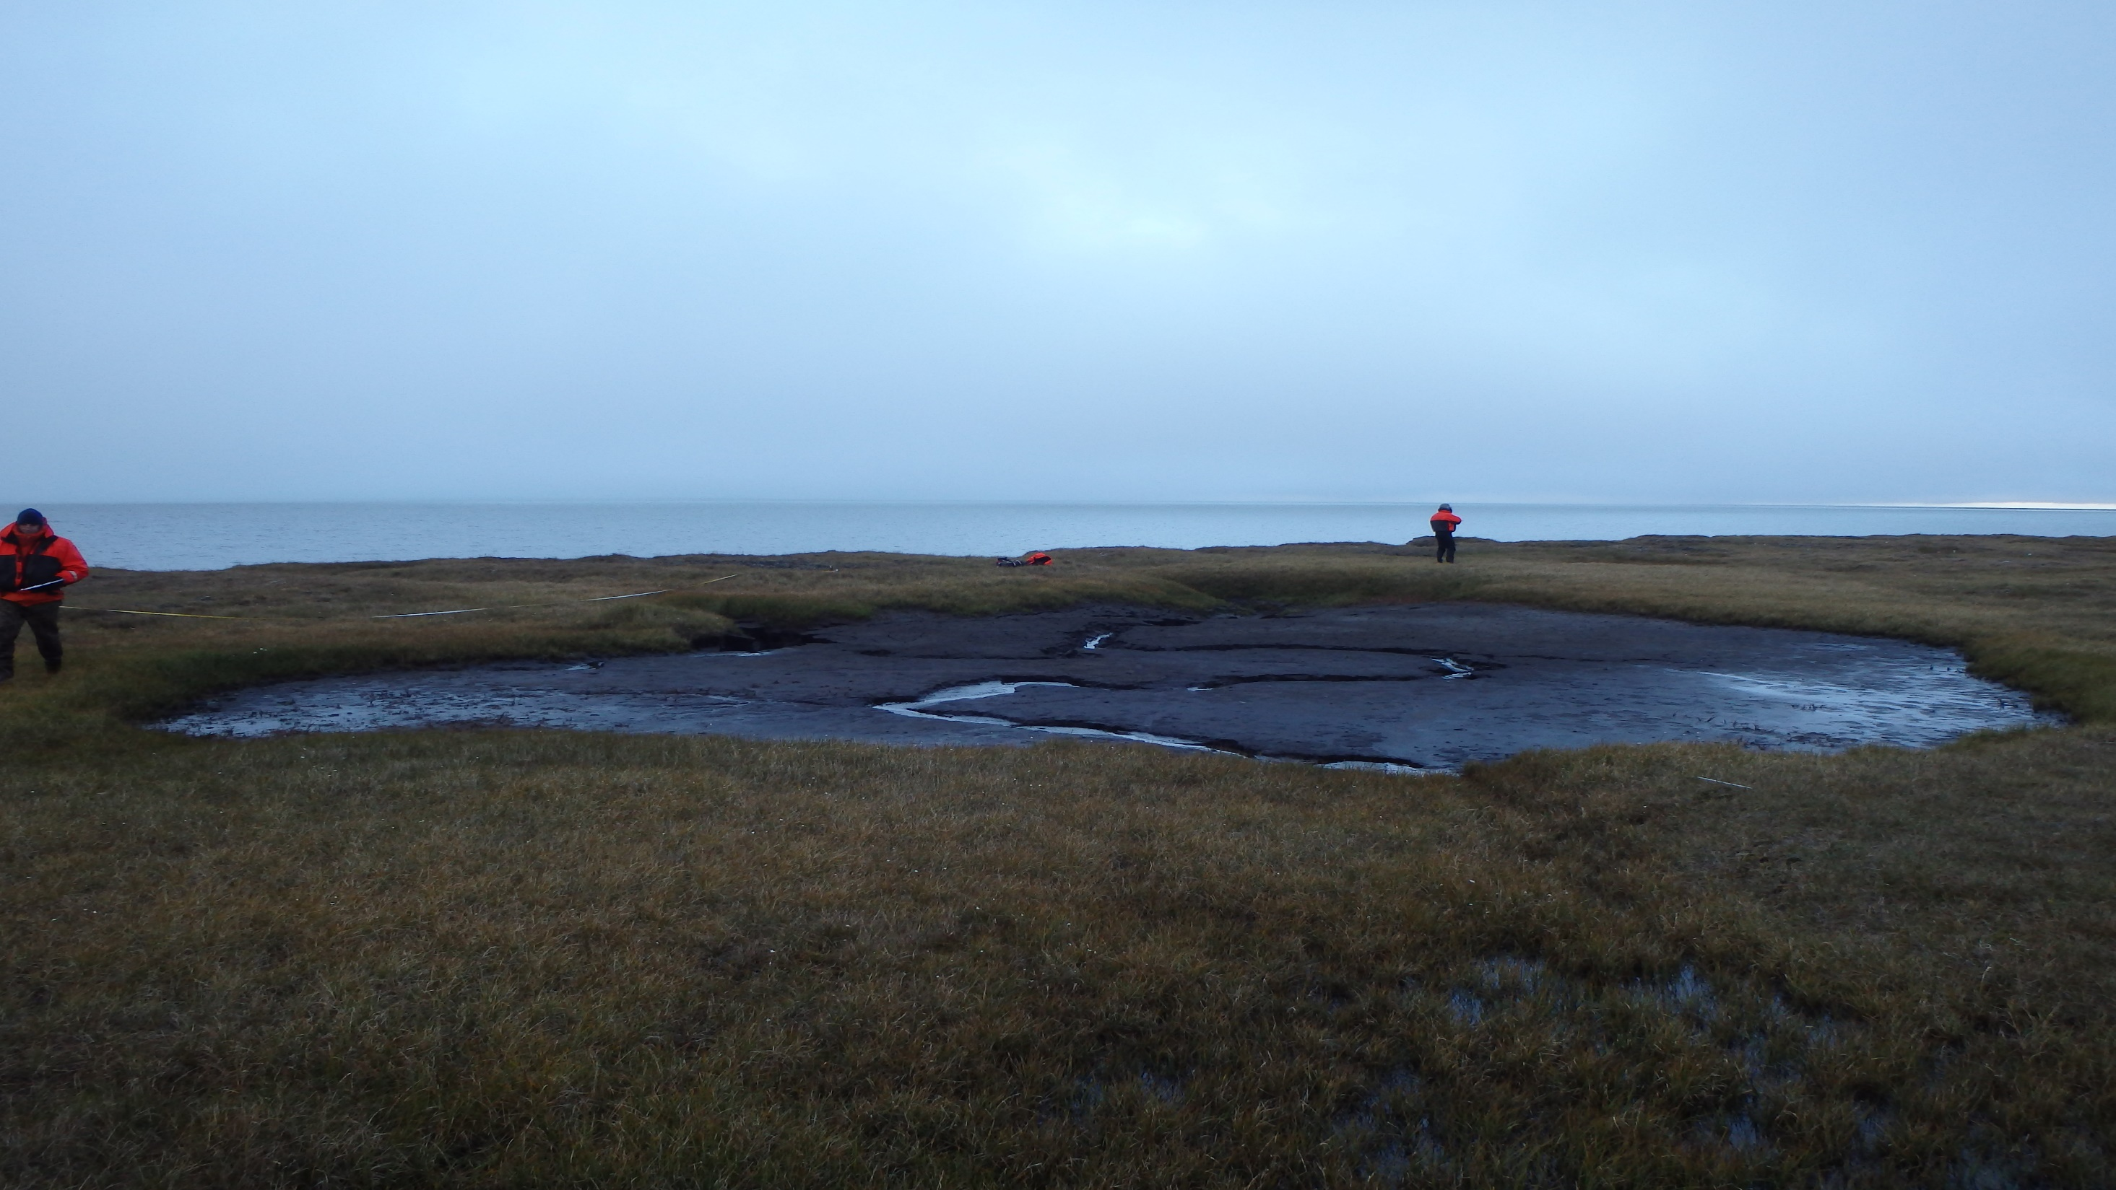
Historic and Recent Coastal Change near Barrow
ARIES Webinar: Coastal Erosion on the North Slope of Alaska
Friday, Sept. 19, 2014

Slide 2
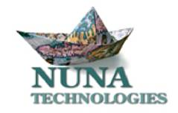
Authorship for this talk – the BAID CIAP Team
Erika Green and Qaiyaan Aiken
Craig Tweedie, Sandra Villarreal, Ryan Cody, Ari Kassin, Keith Kofoed, Abdiel Lopez, Adrian Aguirre, undergraduate students
Allison Gaylord
William Manley and technician

Slide 3
Motivations for Coastal Research
Response to Arctic warming and potential for increased erosion rates
Response to changes in weather and extreme events
Response to sea level rise
Fate and transport of soil organic carbon and nutrients
Impact of erosion on terrestrial and marine ecosystems
Sustainability and subsistence for local peoples

Slide 4
Material to be Presented today
Erosion monitoring along the coastline of the Barrow Environmental Observatory 2003-214.
BOEM/USFWS – Coastal Impact Assistance Program
Wetland mapping
Historic coastal change
Modern coastal change
Web mapping and decision tools
Stakeholder engagement and outreach
Research activities planned in the near future

Slide 5
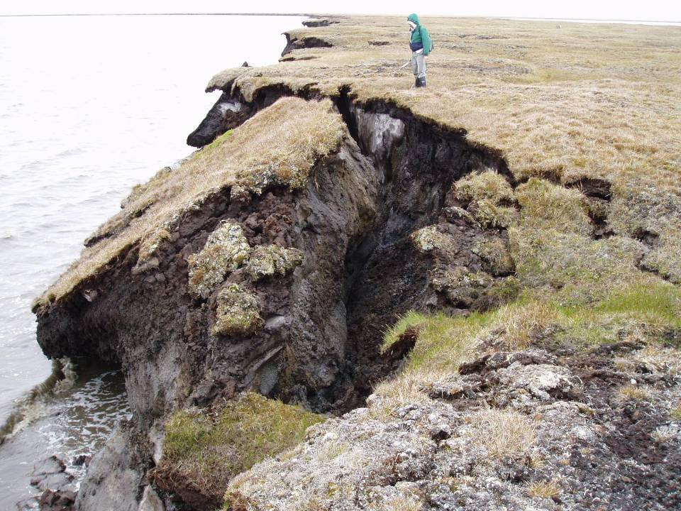

Slide 6
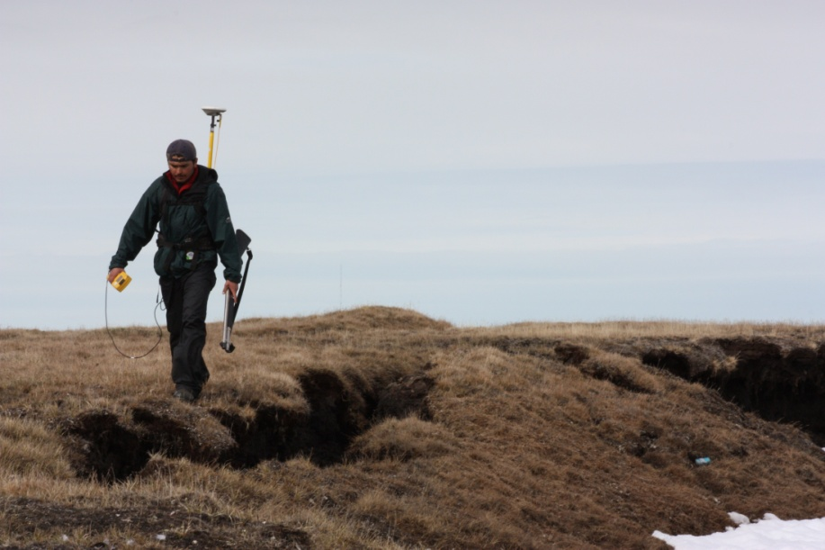
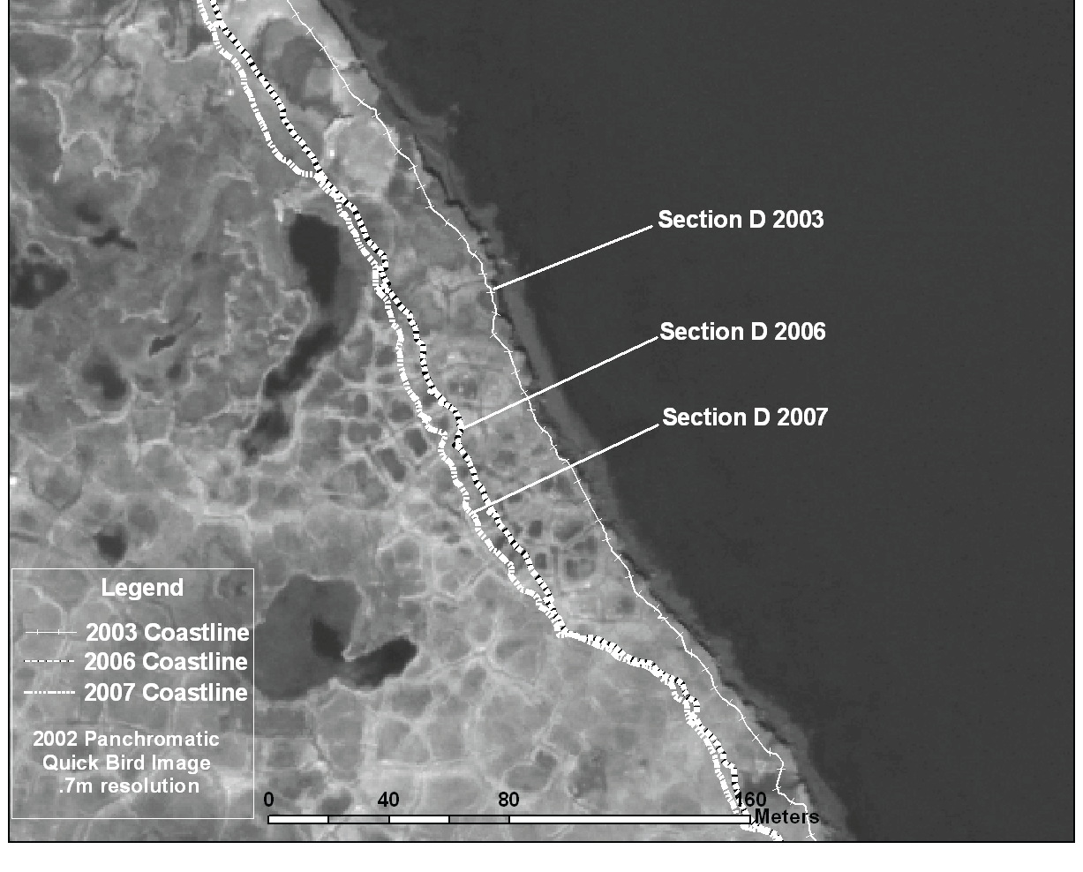
Erosion monitoring BEO Coast 2002 - 2014
DGPS surveys of bluff edge
4 sections A-D
~11km coast

Slide 7
Areal Loss &
Volumetric Loss
2003-13
DGPS surveys processed to polylines
DSAS segments 20m
Volume assumed bluff was vertical

Slide 8
Cumulative Areal Loss
2003-13
DGPS surveys processed to polylines
DSAS segments 20m
Volume assumed bluff was vertical

Slide 9
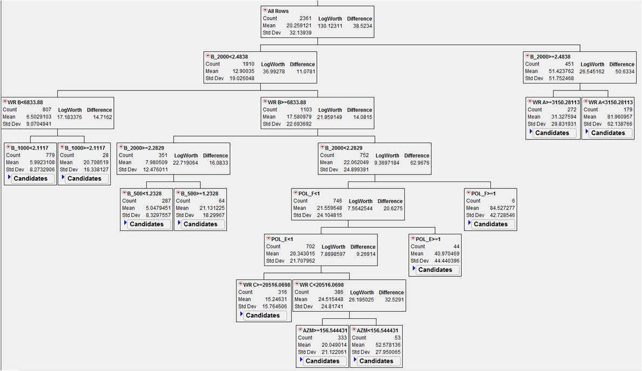
Stepwise Regression Model ~ Areal Loss at Elson Lagoon 2002-2012

Slide 10
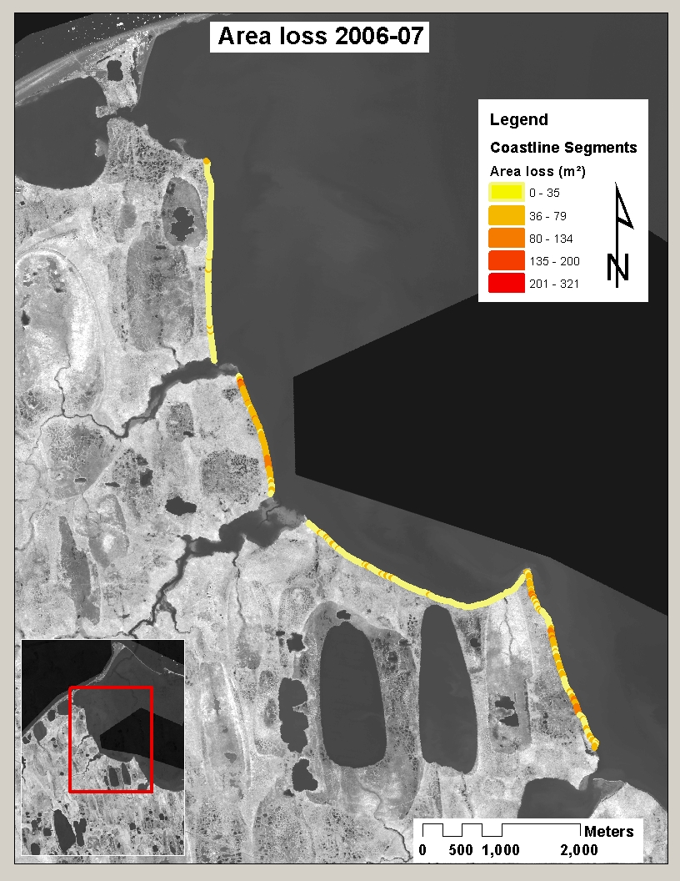
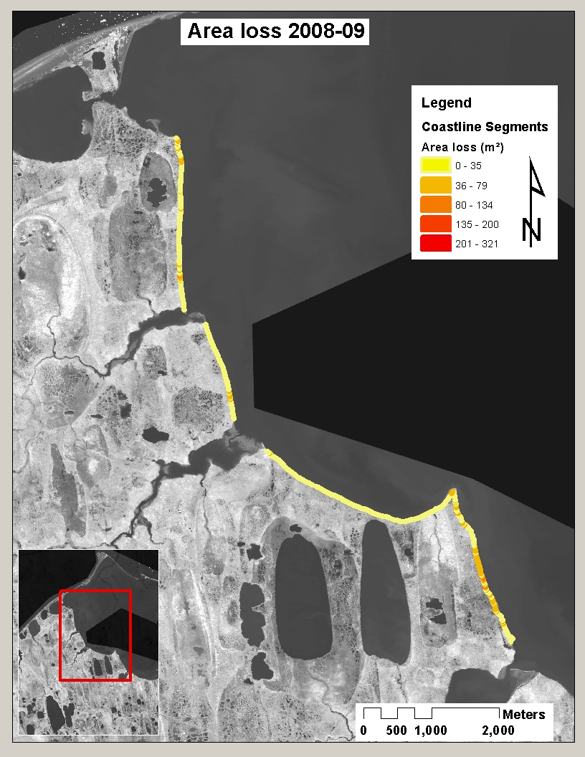
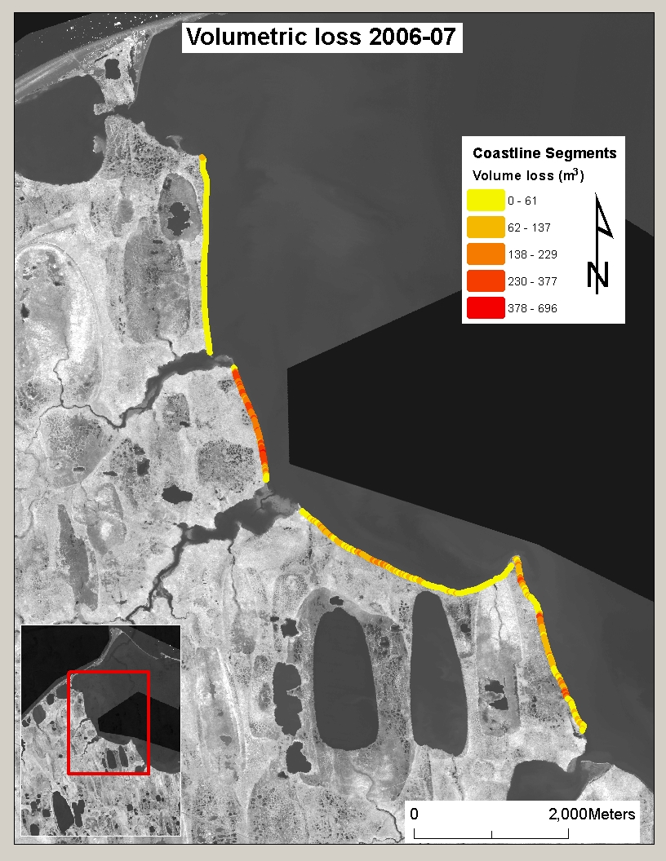
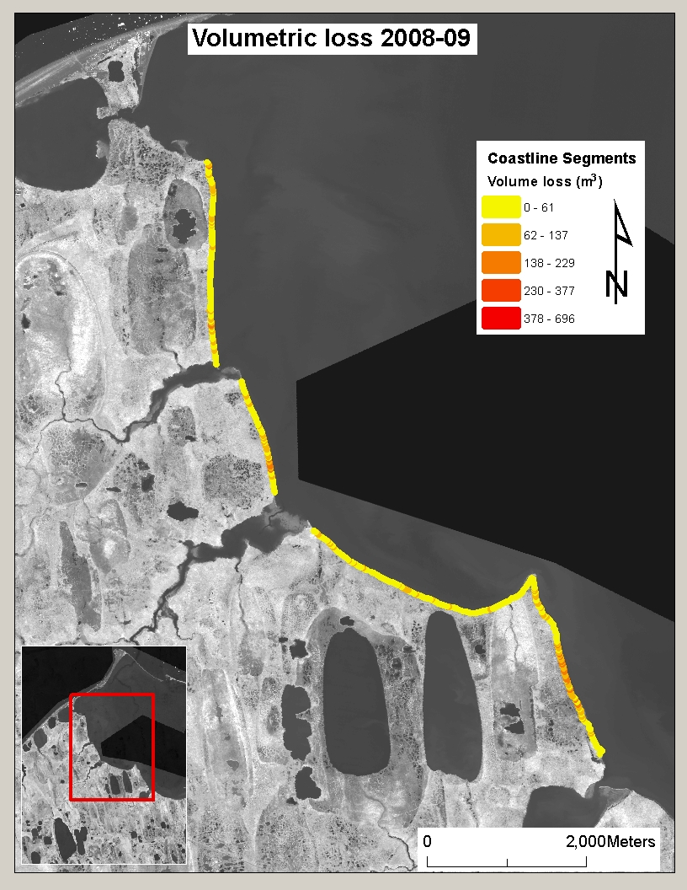
Monitoring of Coastal Erosion Barrow Environmental Observatory 2002-13
10.7km coast
Avg. ~18.5m retreat, 19.3ha loss, in past decade
spatiotemporally variable
Stepwise regression show controls different for areal/volumetric loss
Wave energy (areal)
Landscape (volume)
Notes:
Erosion study

Slide 11
Scaling Measurements to Land-Ocean transfer of soil Carbon
When parameterized with mean published soil C content and measured loss to erosion, estimates of soil transfer to Elson Lagoon increases 30-100%

Slide 12
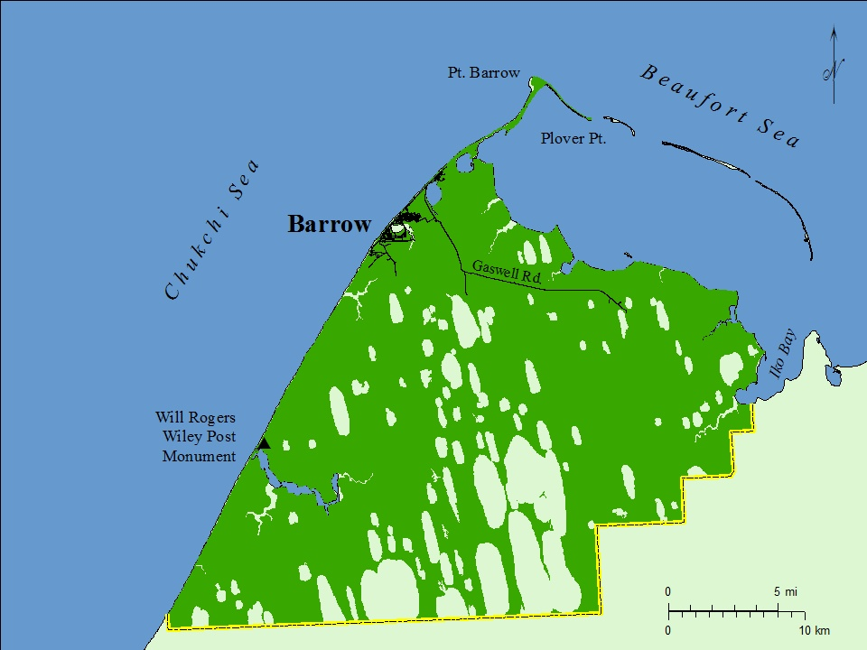
BAID-CIAP (2013 – 2016) Study Area
UIC Land area is approx. 900 sq km, 84 km of coastline Mapped study area will include approx. 1500 sq km
Multiple components

Slide 13
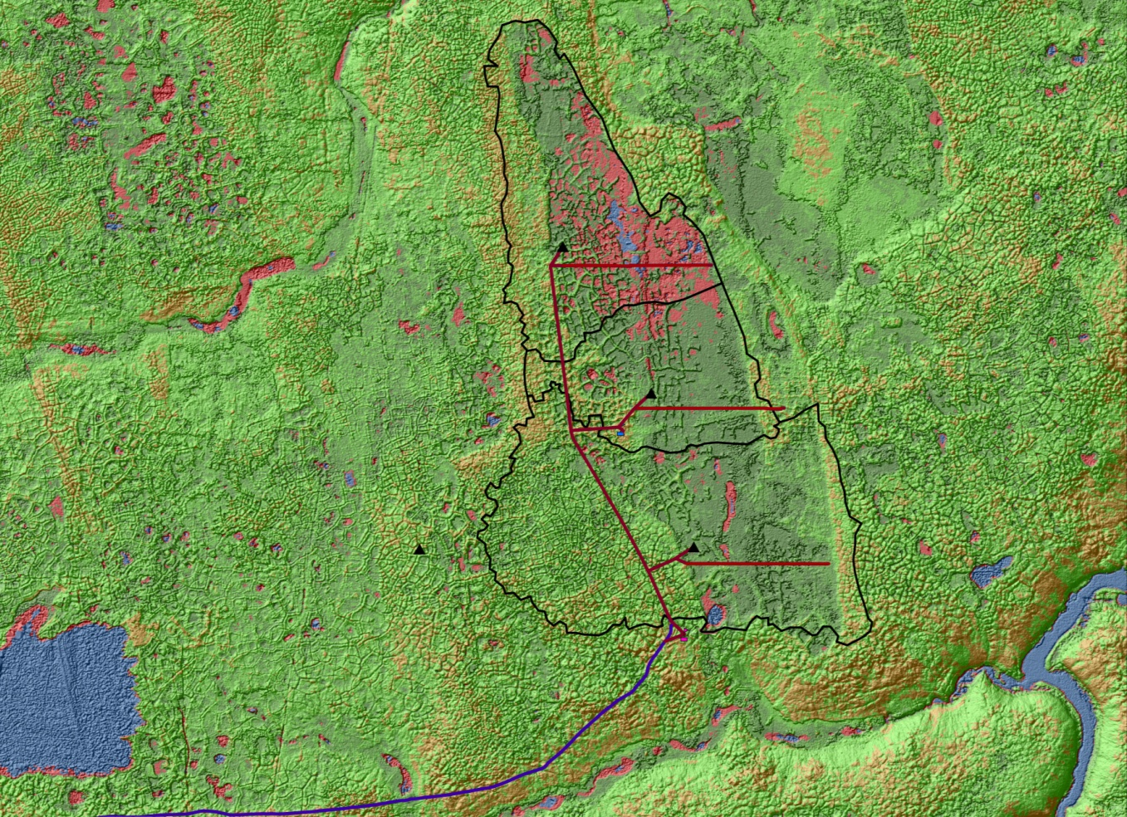
Example land cover mapping
Wetland delineation to follow
WV2 Imagery 2009-13
Accuracy Assessment

Slide 14
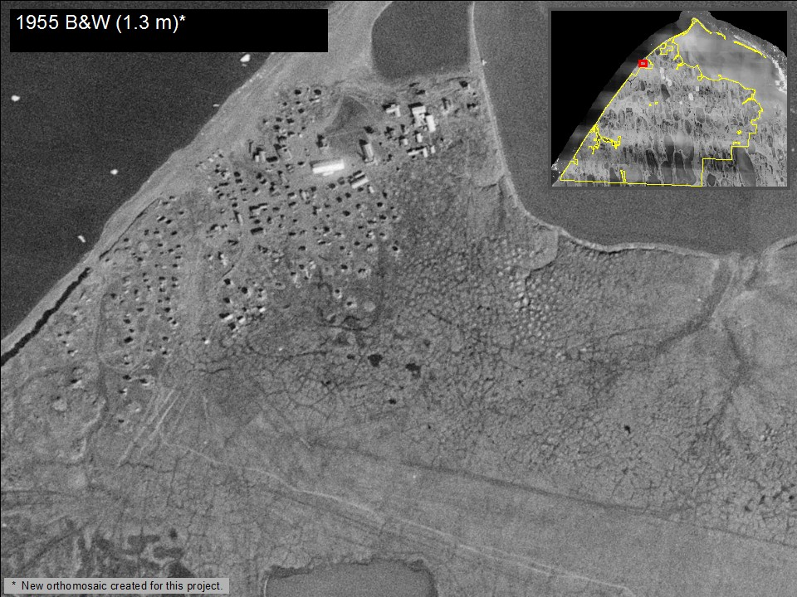
Historic Imagery

Slide 15
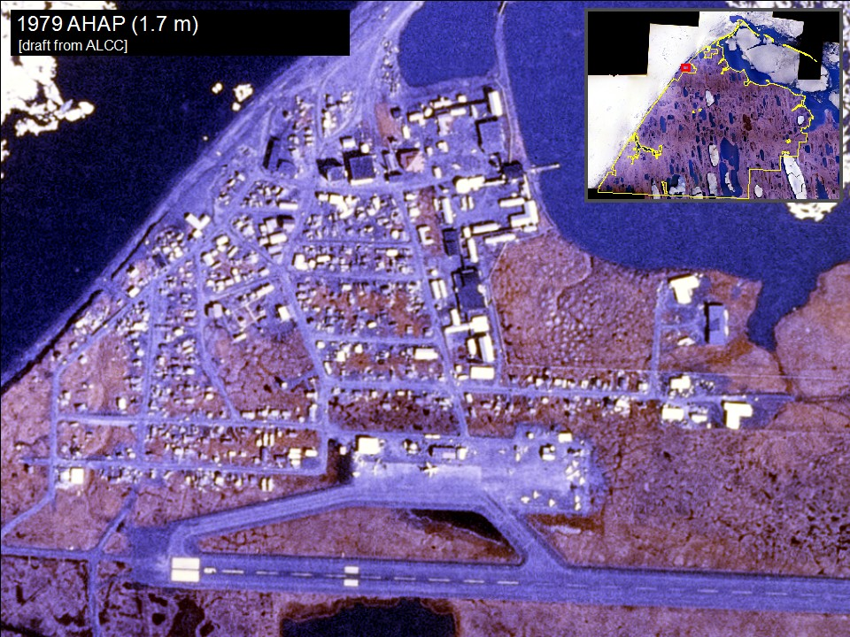
Historic Imagery

Slide 16
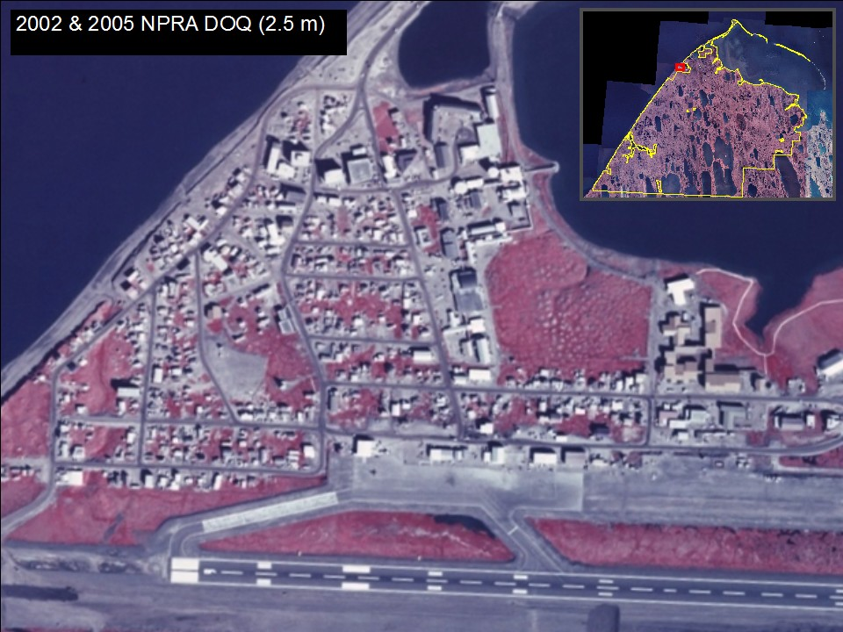
Historic Imagery

Slide 17
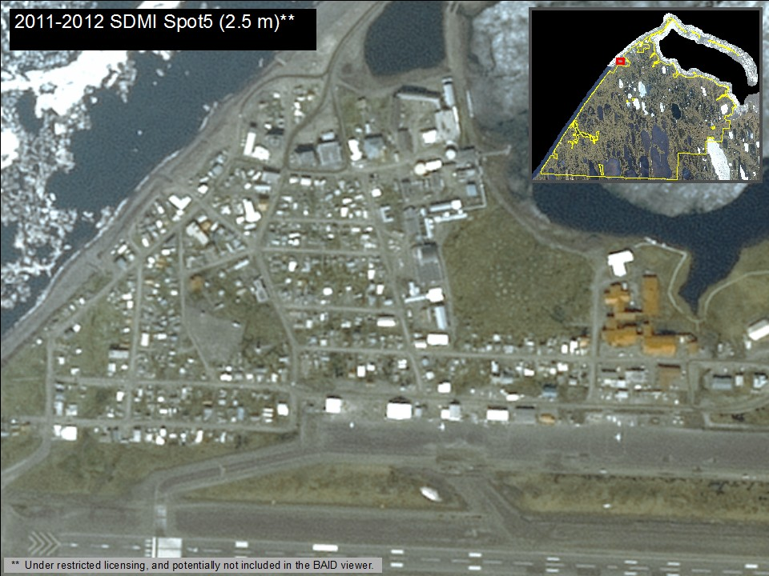
Historic Imagery

Slide 18
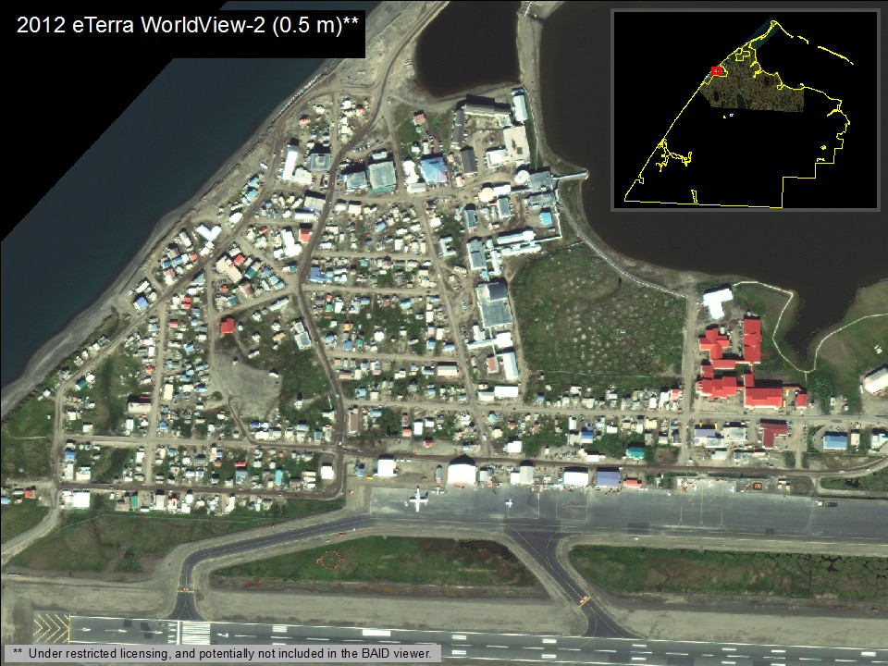
New Imagery

Slide 19
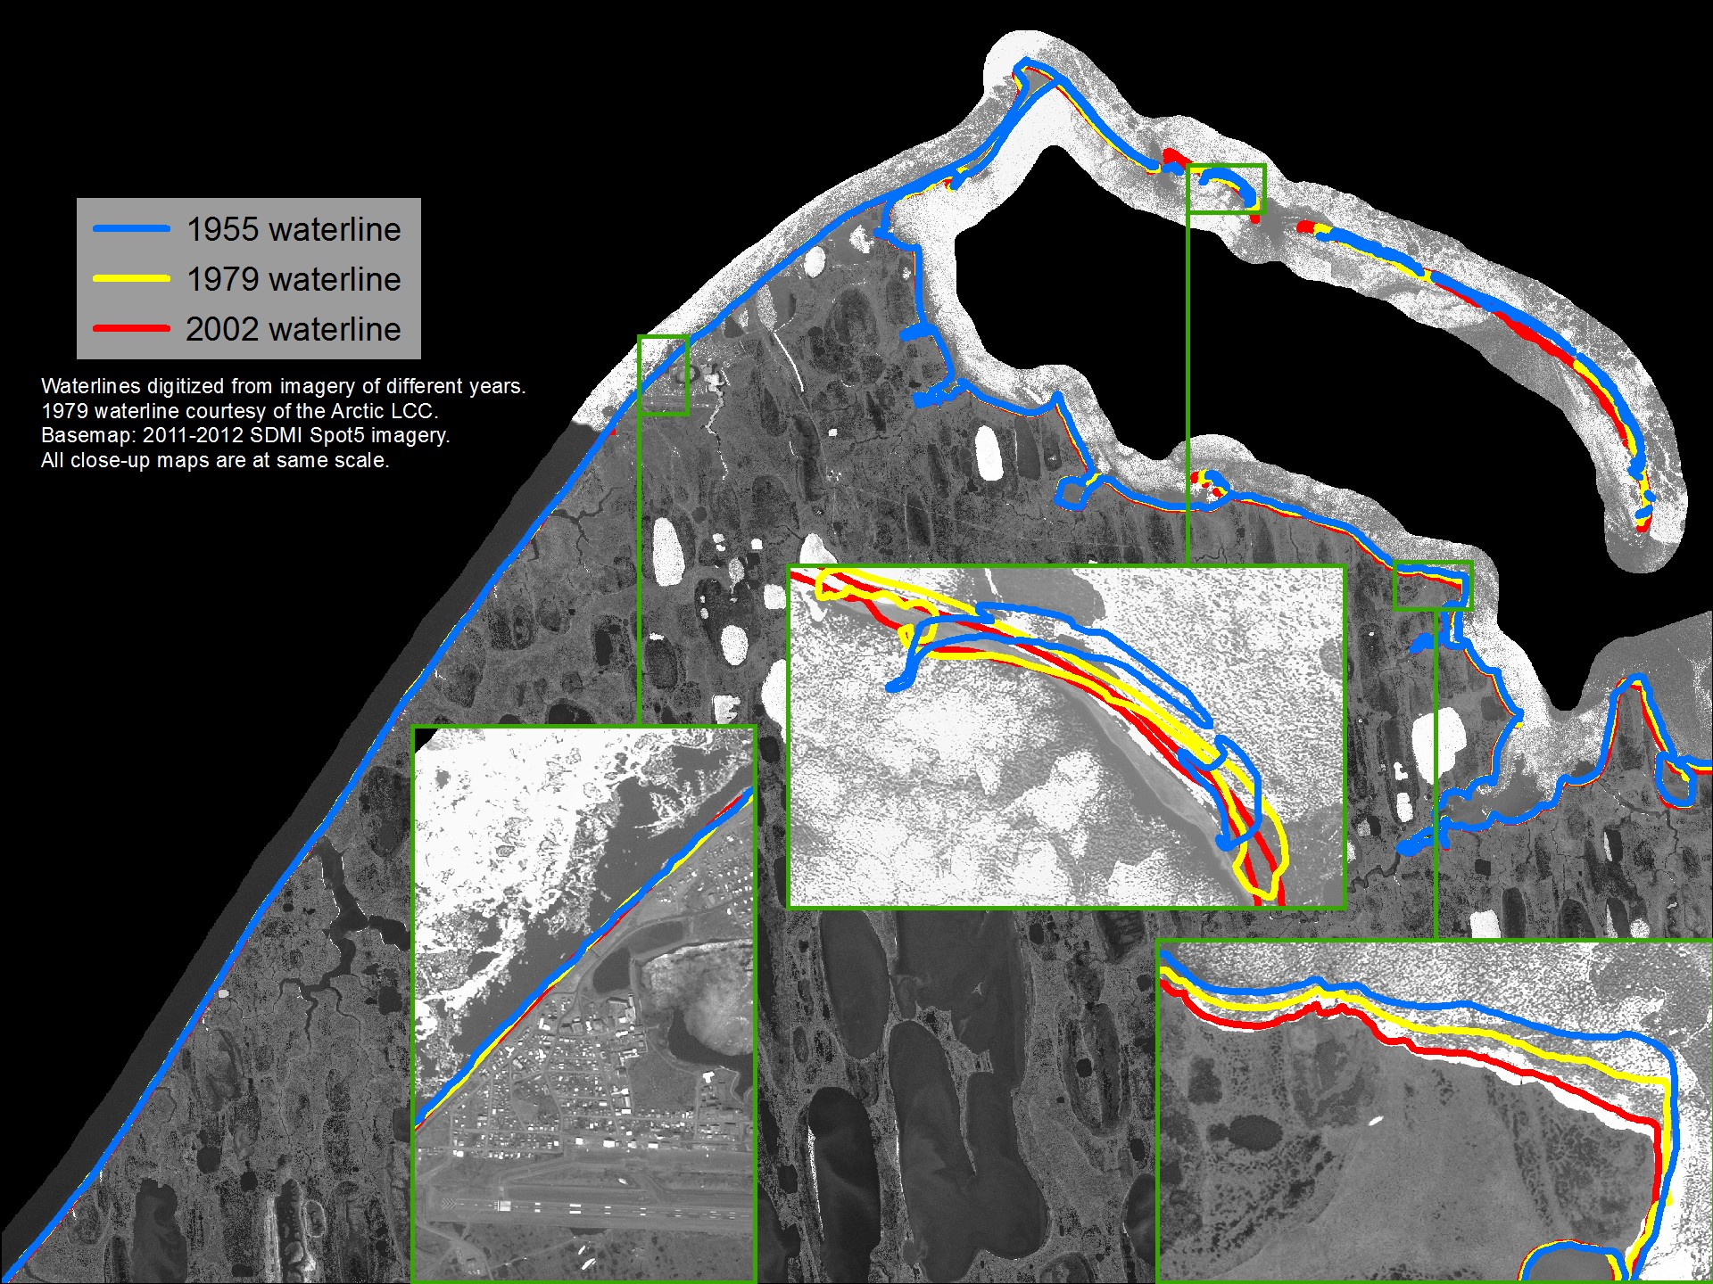
Digital Shorelines
Analysis will also include shorelines from 2010-2014 WV2 imagery.

Slide 20
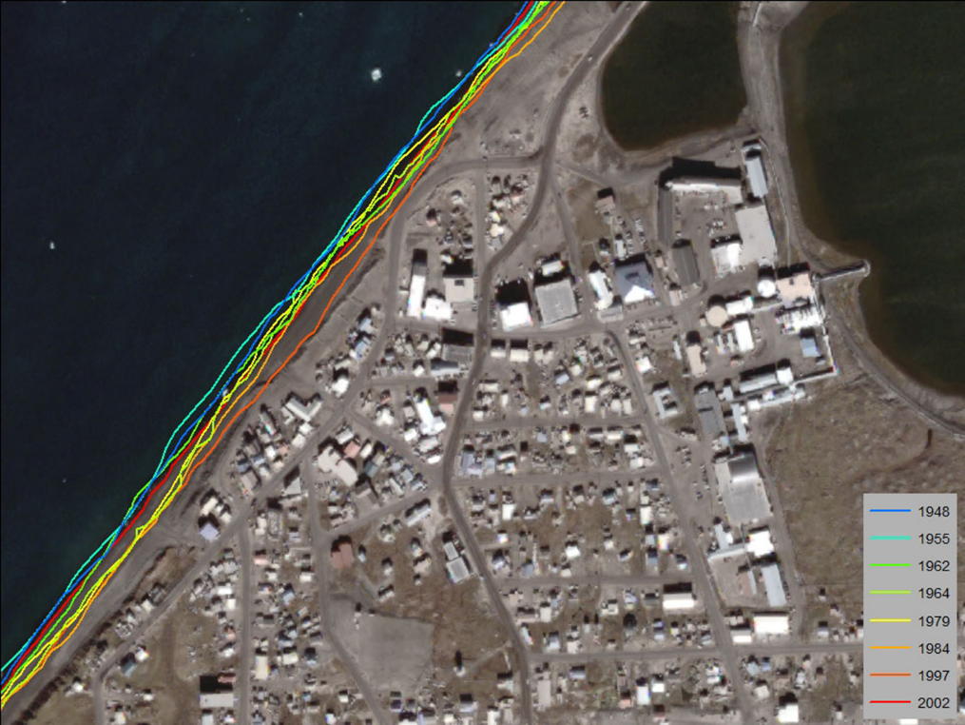
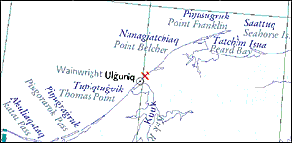
Geodatabase Development
Compiling info from numerous entities
Wealth of historic imagery & shorelines compiled including relevant info from related studies
Key data sets provided by Planning & Umiaq (imagery, land ownership, infrastructure, place names)
Wildlife interaction layers – need to follow up on synthesis data (critical habitat rather areas rather than individual denning sites, nests, etc.)

Slide 21
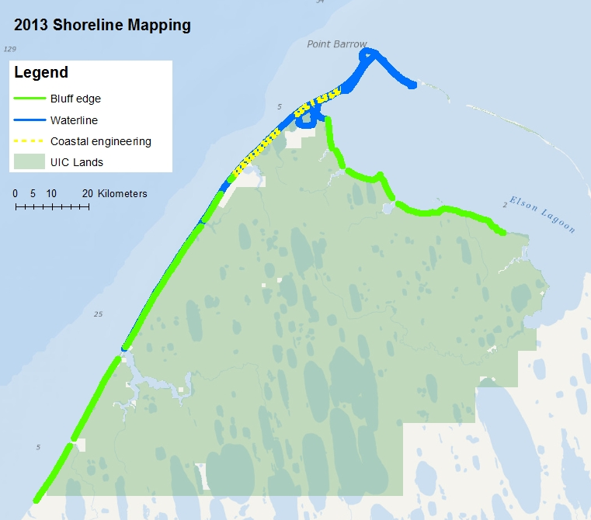
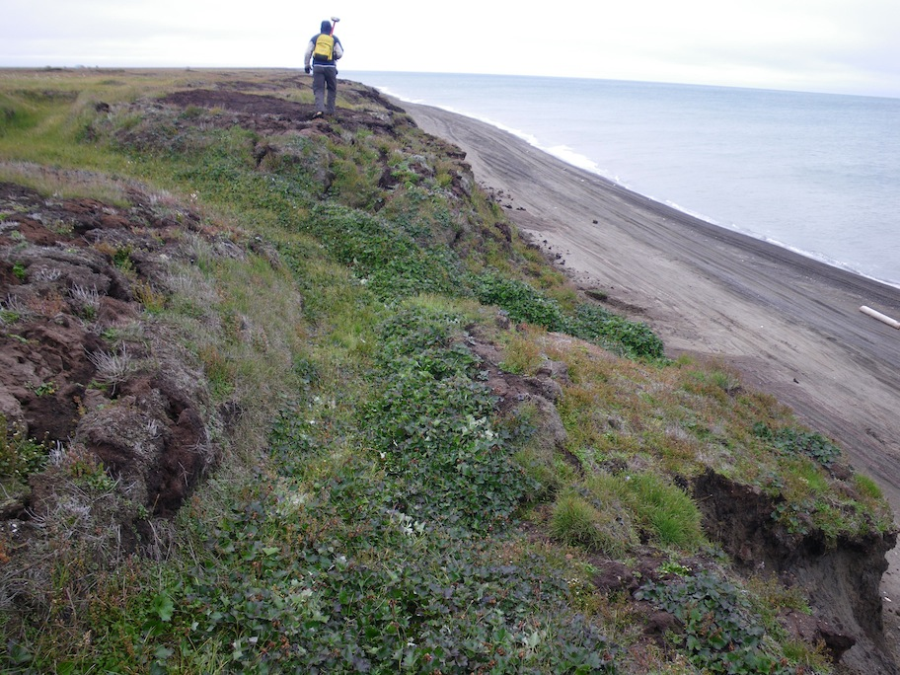
Coastal Erosion Mapping
84 km coastline (all but 7 mi captured in 2013)
Shoreline Reference Features -bluff edge -waterline -coastal engineering
Long term monitoring sites on Elson Lagoon

Slide 22
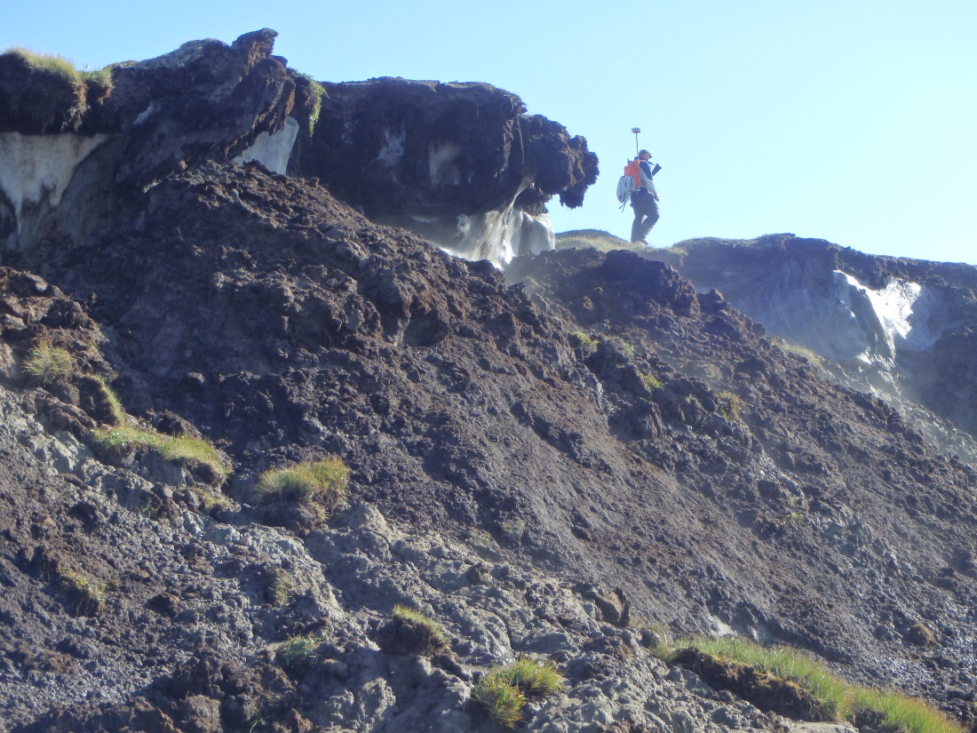
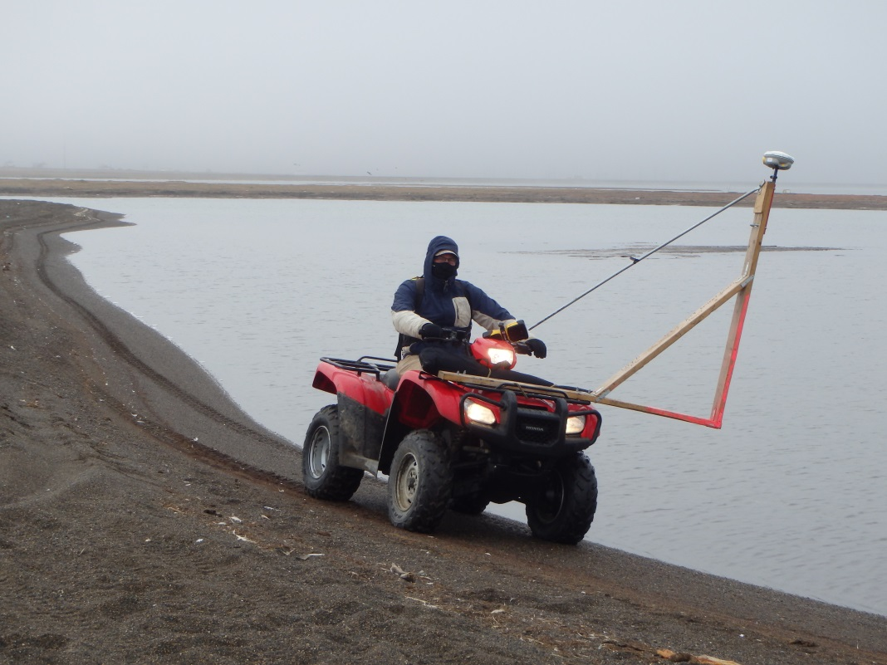
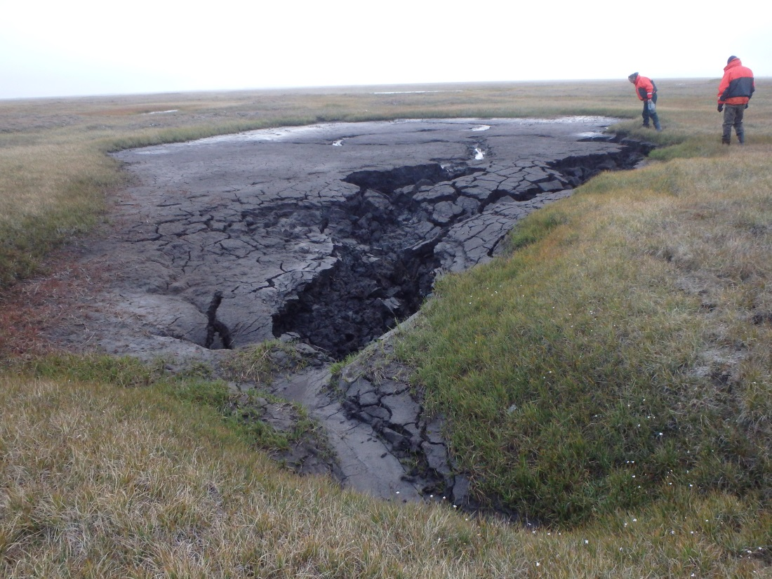
Mapping bluff edge and waterline with DGPS

Slide 23
Decision Support Tools
To assist local stakeholders with community tasks
coastal development, conservation priorities, endangered and subsistence species protection, oil spill response, planning and zoning for vulnerable areas, etc.
Visualize and synthesize from map layers and other input
existing development, land ownership, wetland types, habitat preference for endangered wildlife, height above sea level, etc.
Provide specific output for printing or saving maps, information, and reports
Help enable sustained community development

Slide 24
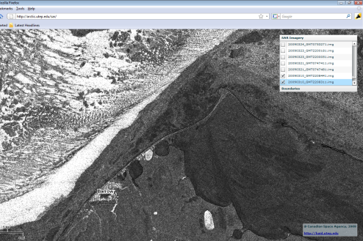
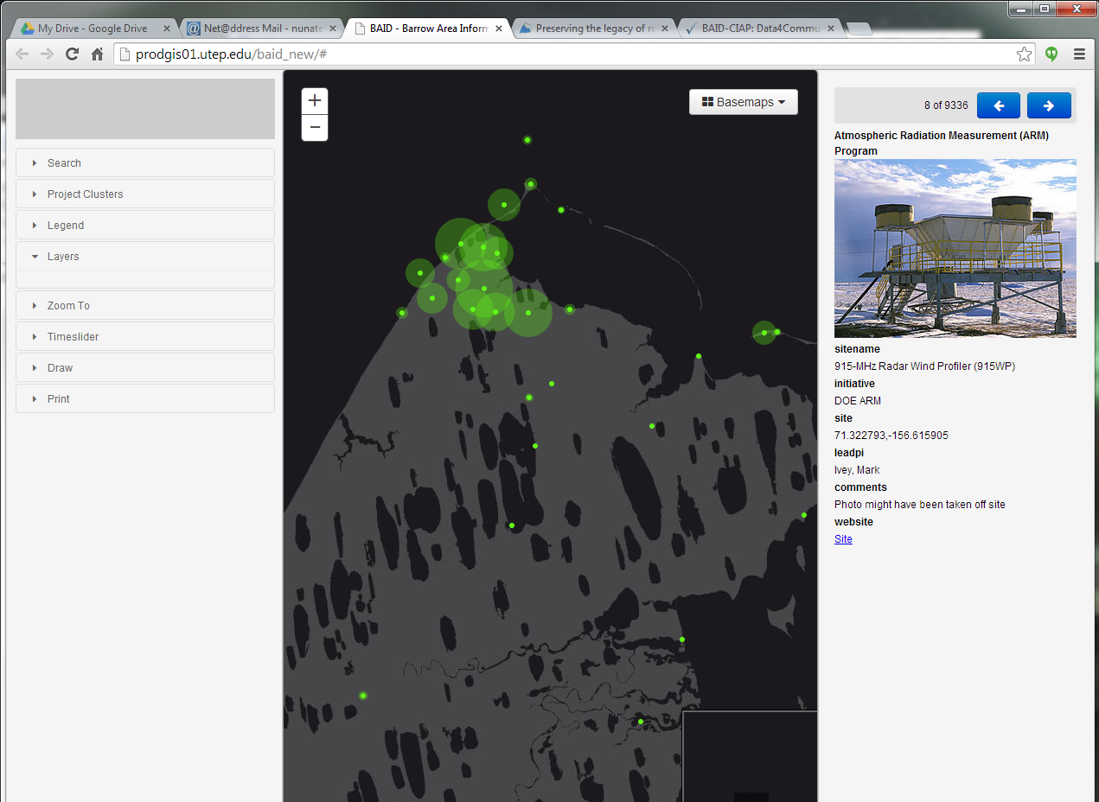
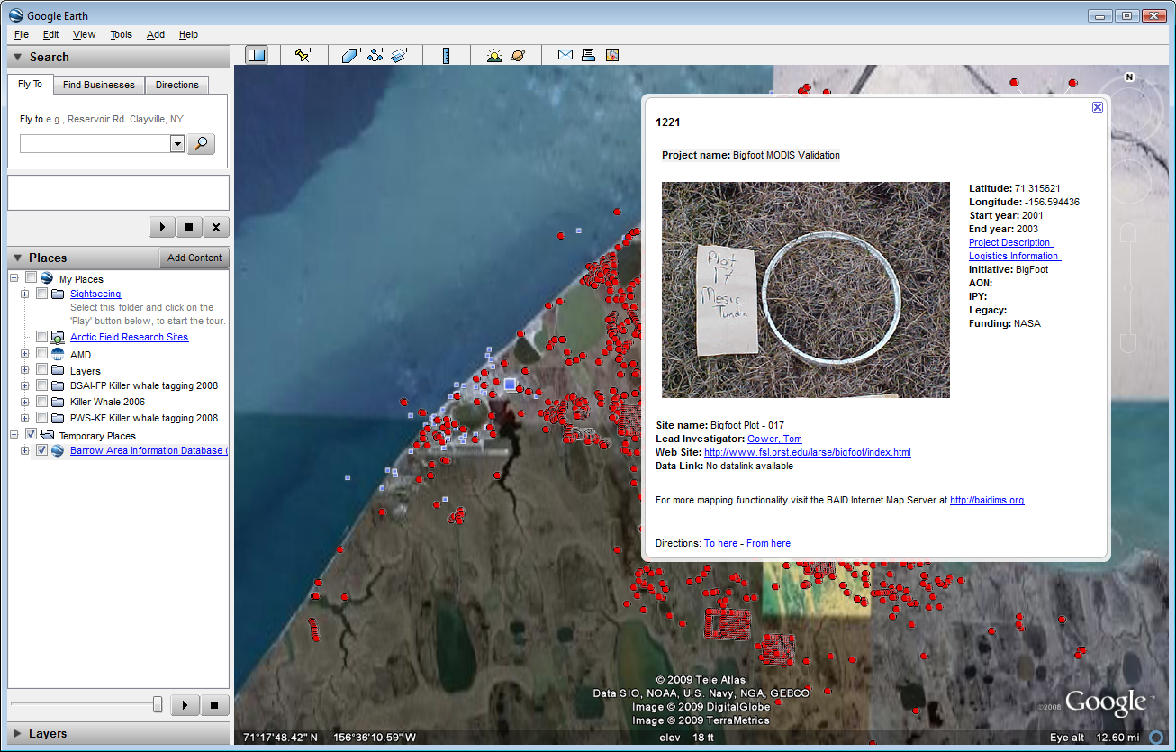
Targeted “Web Map Apps”
Gallery of focused applications for specific user needs
Easy to use
Designed to fit within a workflow
Provide for informed decision making
Coastal Monitoring Community Planning Imagery Time Slider
Sea ice viewer Research Sites BAID in Google Earth

Slide 25
Erosion Assessment Tool
Help assess vulnerability
Take advantage of digital shorelines and other data layers
land cover type, bathymetry, sea ice, etc.
Interactively visualize erosion trends
Help enable sustained community development

Slide 26
Stakeholder Participation
BAID Advisory Council of local land management entities Provides guidance on Decision Support Tools to assist the Barrow community with decision making and optimization of sustainable, low-impact community development.
Participating entities:
Arctic Slope Regional Corporation Ukpeaġvik Iñupiat Corporation (UIC) North Slope Borough City of Barrow Native Village of Barrow

Slide 27
Scoping with Stakeholders
Advisory Council & Community meetings
Follow up Discussions with NSB Planning
Discussions with NSB Emergency Management and ARIES team regarding monitoring of priority infrastructure
Reviewed NSB Permit Applications
Reviewed Umiaq Permit Applications
Participated in Umiaq BEO Science Planning Meetings

Slide 28
Stakeholder Feedback
Expert guidance in 2014-2015 is critical to ensure the apps will be helpful.
How could the new wetlands map be applied in workflows for decision making?
Could synthesized information on erosion rates be used for comprehensive planning?
Specific recommendations for the tools? Priority data layers?
Where are the most important areas?
How should we handle maintenance of dynamic data layers?

Slide 29
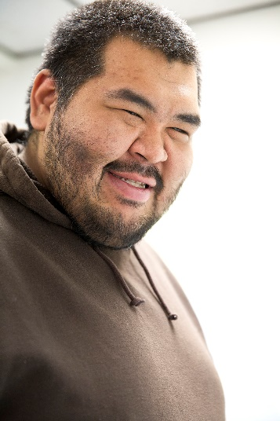
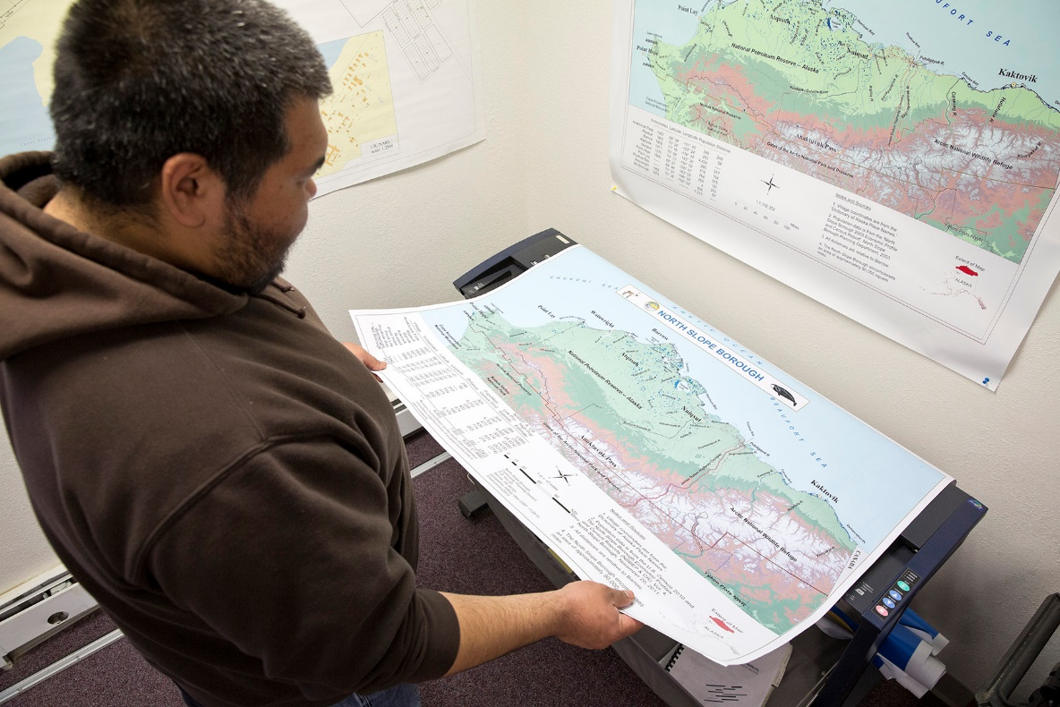
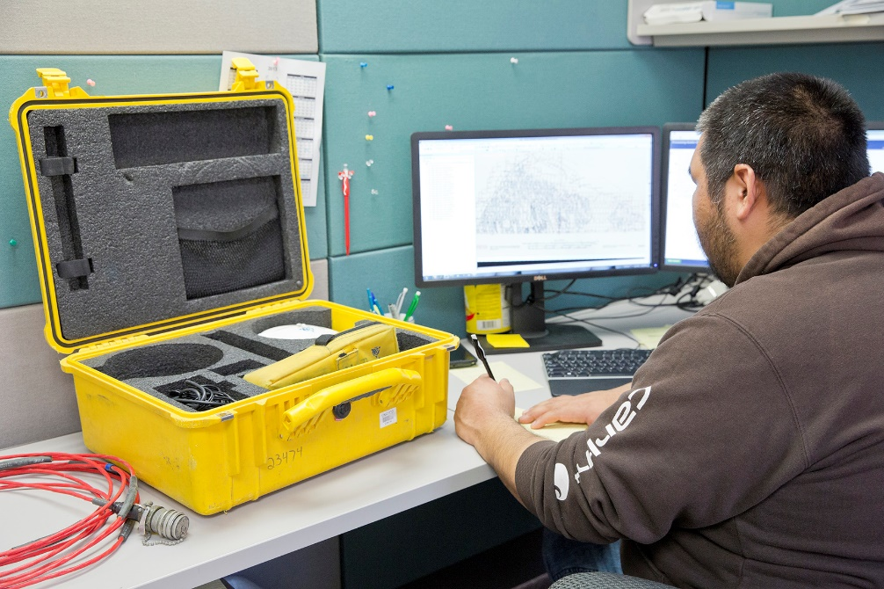
Stakeholder Participation
Local Expertise and Capacity

Slide 30
Ongoing and Other Activities
All activities above to continue in 2015
Time lapse photography (7 total)
5-node micromet stations deployed (3 on coast)
New seismic sensor for measuring wave impact prototyped in 2014
Terrestrial lidar of Chukchi Coast ~200 x 100m 2012-14
Kite Aerial Photography and derived DEMs (UAV in 2015?)
Near shore bathymetry mapping
Pressure sensors, water temp., underwater time lapse camera
Water chemistry – pCO2, pH, alkalinity, turbidity, C, N, sediment characterization – sensor system prototyped in 2013

Slide 31
Thanks – Questions?
Notes:
****Add collaborators, students, funding agencies

